Slide 1

Point of Rental Training
Please proceed at your own pace. Press the right arrow key to move though the training or left to go back, each slide will automatically advance after a few seconds.

Slide 2
item creation
Sales Header

Slide 3
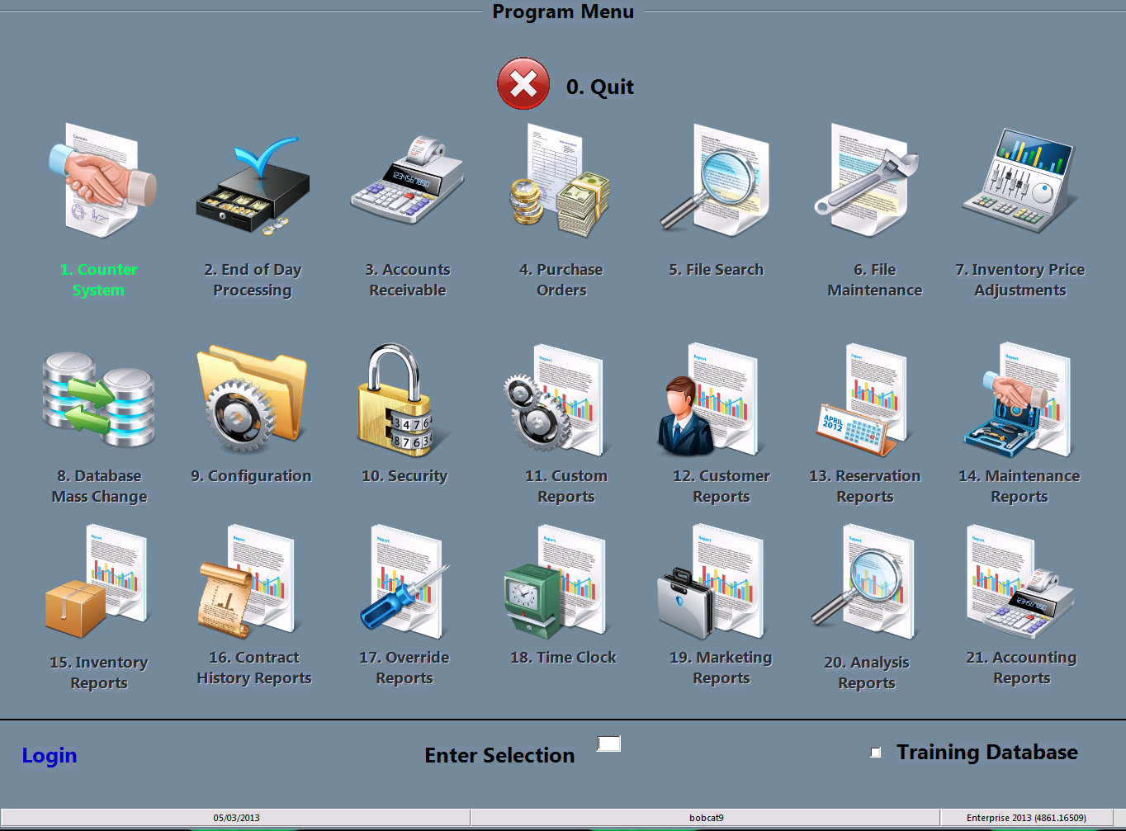
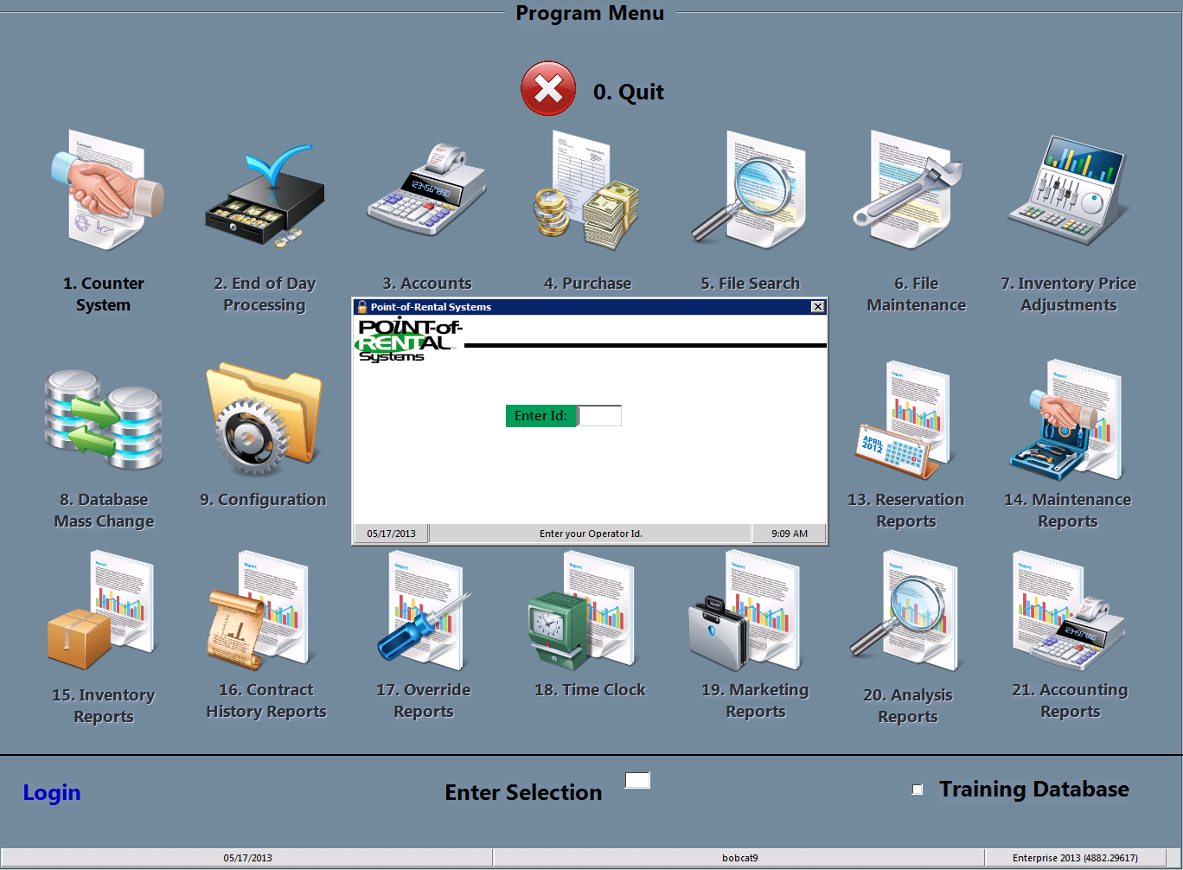
Select login
You must start by clicking the Login at the bottom left of the screen and typing in your password.

Slide 4
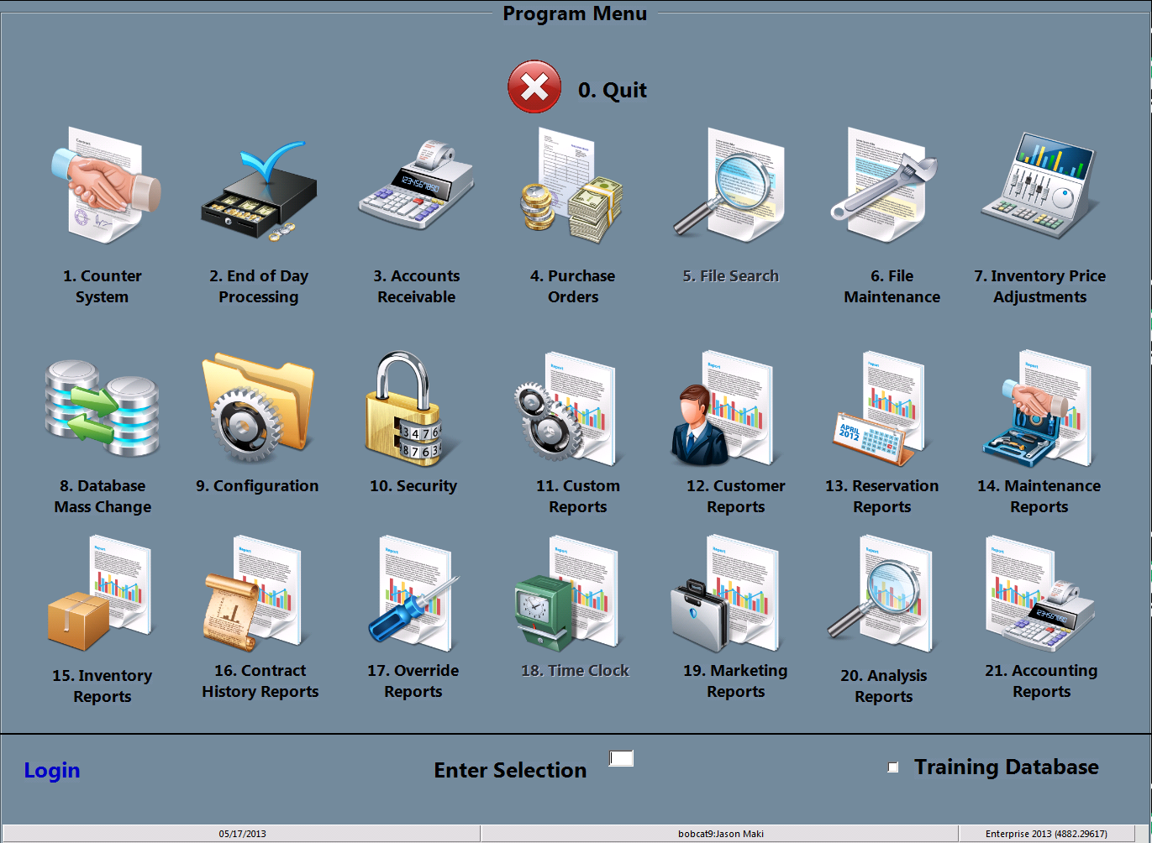
Select File maintenance
You may either double click the File Maintenance icon or type the #6 in the “Enter Selection” space then press enter

Slide 5
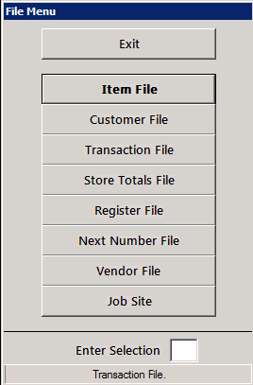
Select item file
You may either double click the item file icon or type the #1 in the “Enter Selection” space then press enter

Slide 6
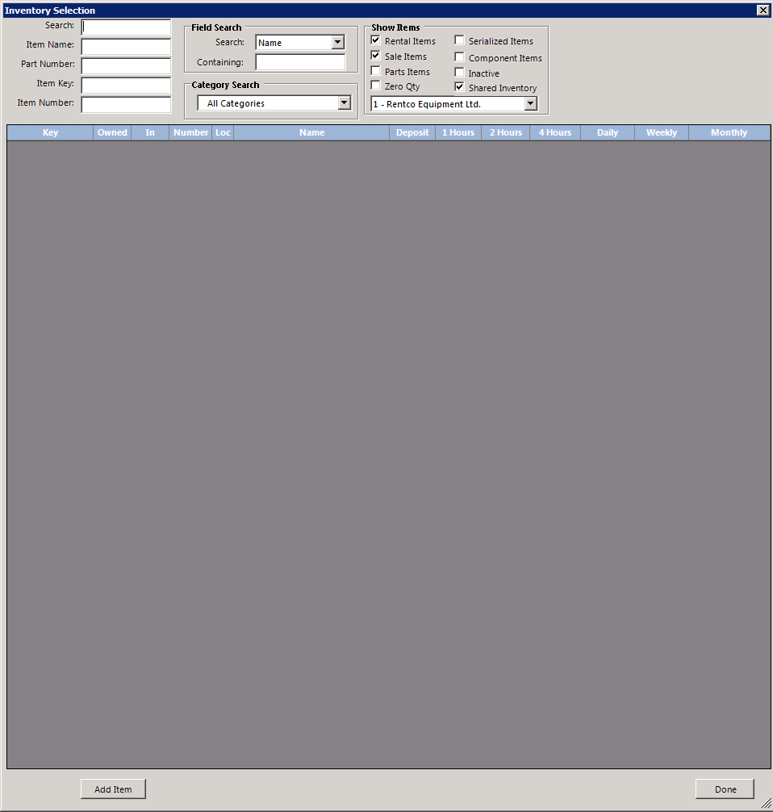
Select Add item
You may now select the Add Item button at the lower left of the screen by clicking it

Slide 7
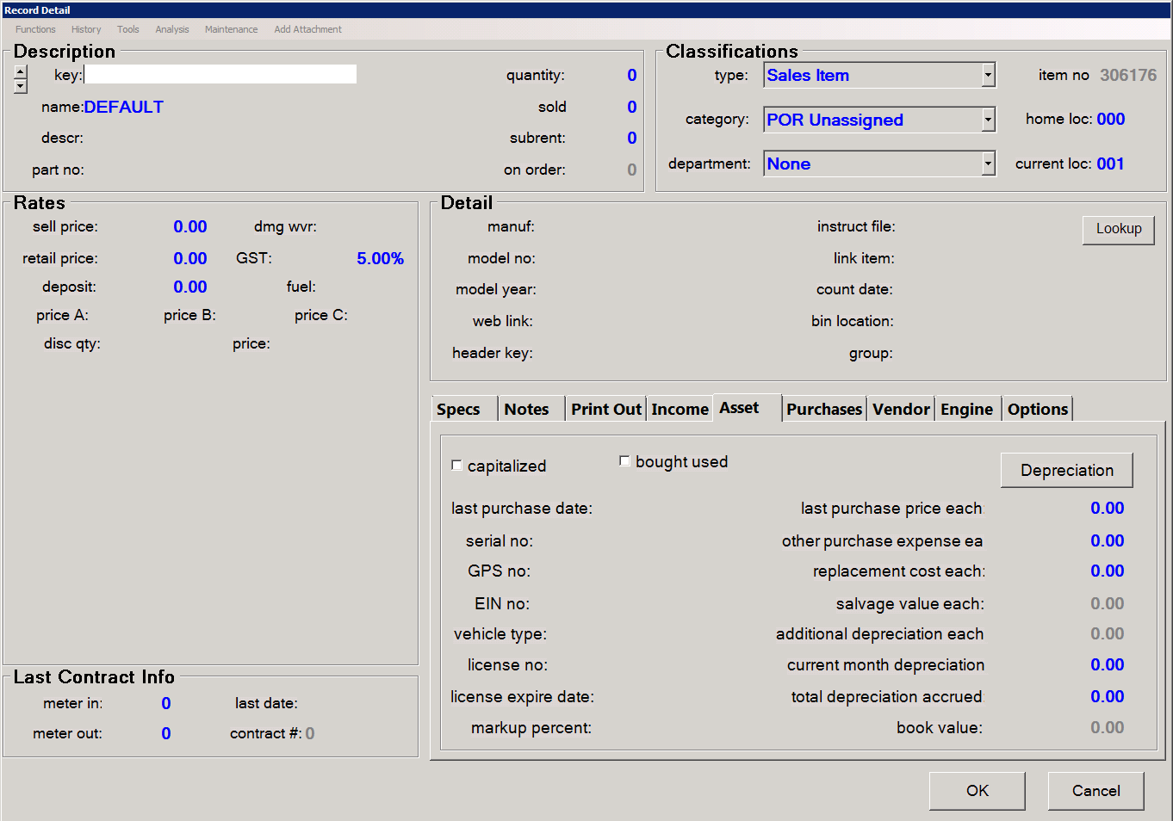
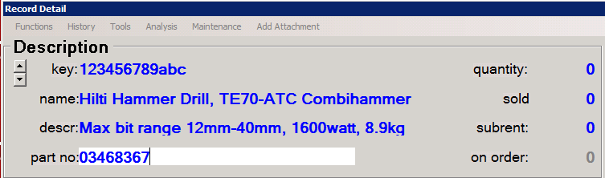
Enter item description
Sales item keys are either the manufactures part number, the serial number or a part number with a prefix such as “BC” for bobcat, see management for the proper key for your item.
Name is simply the name, usually a generalized name followed by more in depth name for instance “Hilti Hammer Drill, TE70-ATC Combihammer”
Descr: is a more detailed description for quick reference
Part no: is the manufactures part number.
Quantity, sold, subrent, and on order are not entered here.

Slide 8
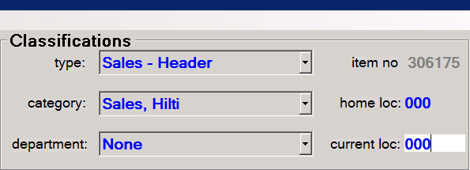
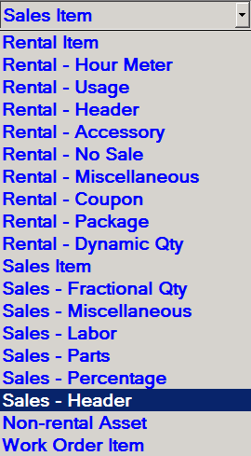
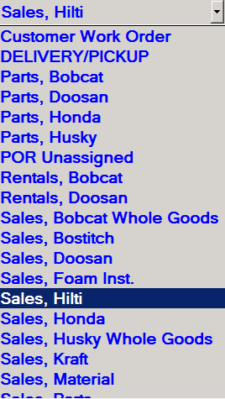
Enter Classification
For item type you should select Sales – Header, simply click the drop down menu,
Select the category that best fits your item
Department is left blank
Item number is filled in by point of rentals
Home loc and current loc are always 000 for header items

Slide 9
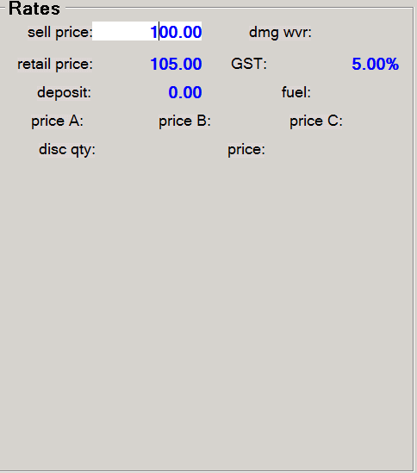
Enter rates
For sell price enter the price we are selling the item for
Retail price is the manufacturer suggested list price
Deposit is the amount required for special order (generally not used)
GST should always be 5% and should not be edited

Slide 10
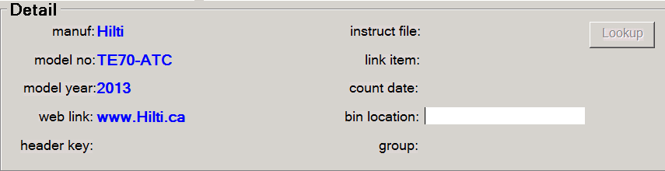
Enter detail
Fill in as many of the fields as you can, header key: should be left blank as well as link, count date, instruct file, bin location and group.

Slide 11
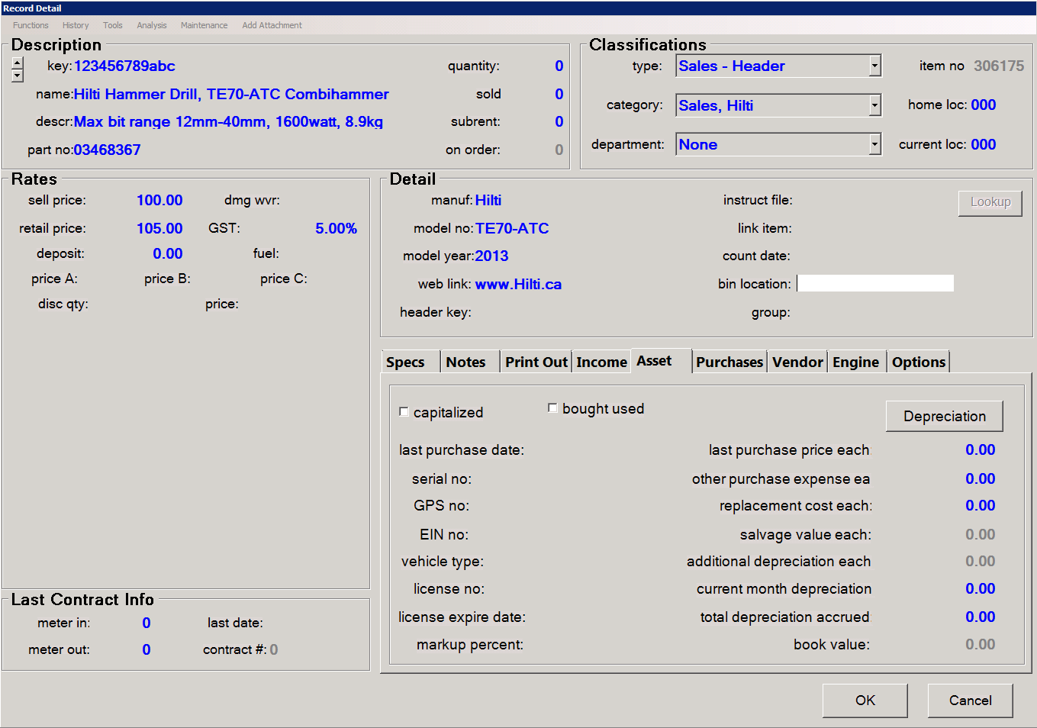
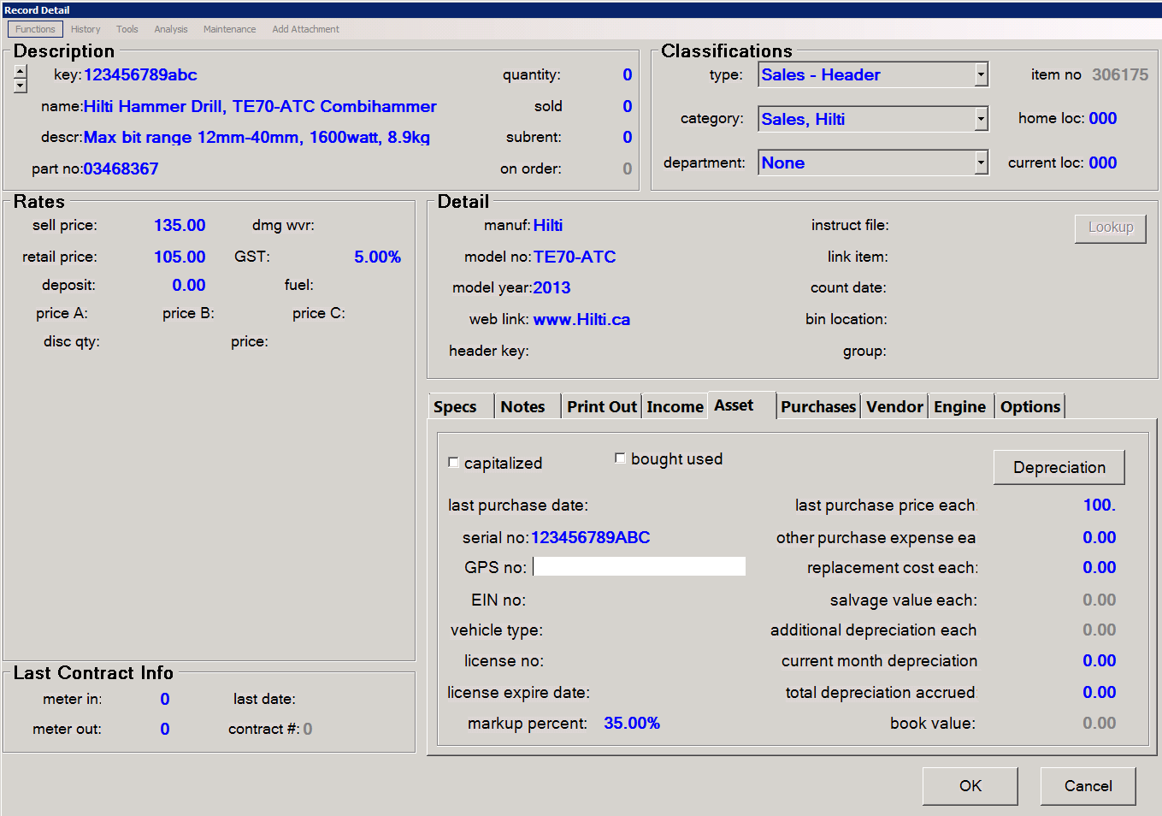
tabs
Select each tab and fill in the corresponding information.
The Specs tab is item specific specs such as weight, power output and other information that people may ask about.
Notes are notes that sales staff can use as a reference, these are not visible on contracts
Print out is the same as notes but will print on an invoice
Income is not editable
Asset is where purchase price, serial numbers and markup may be put. Markup should only be used if you want to set a percentage of markup instead of a set price.

Slide 12
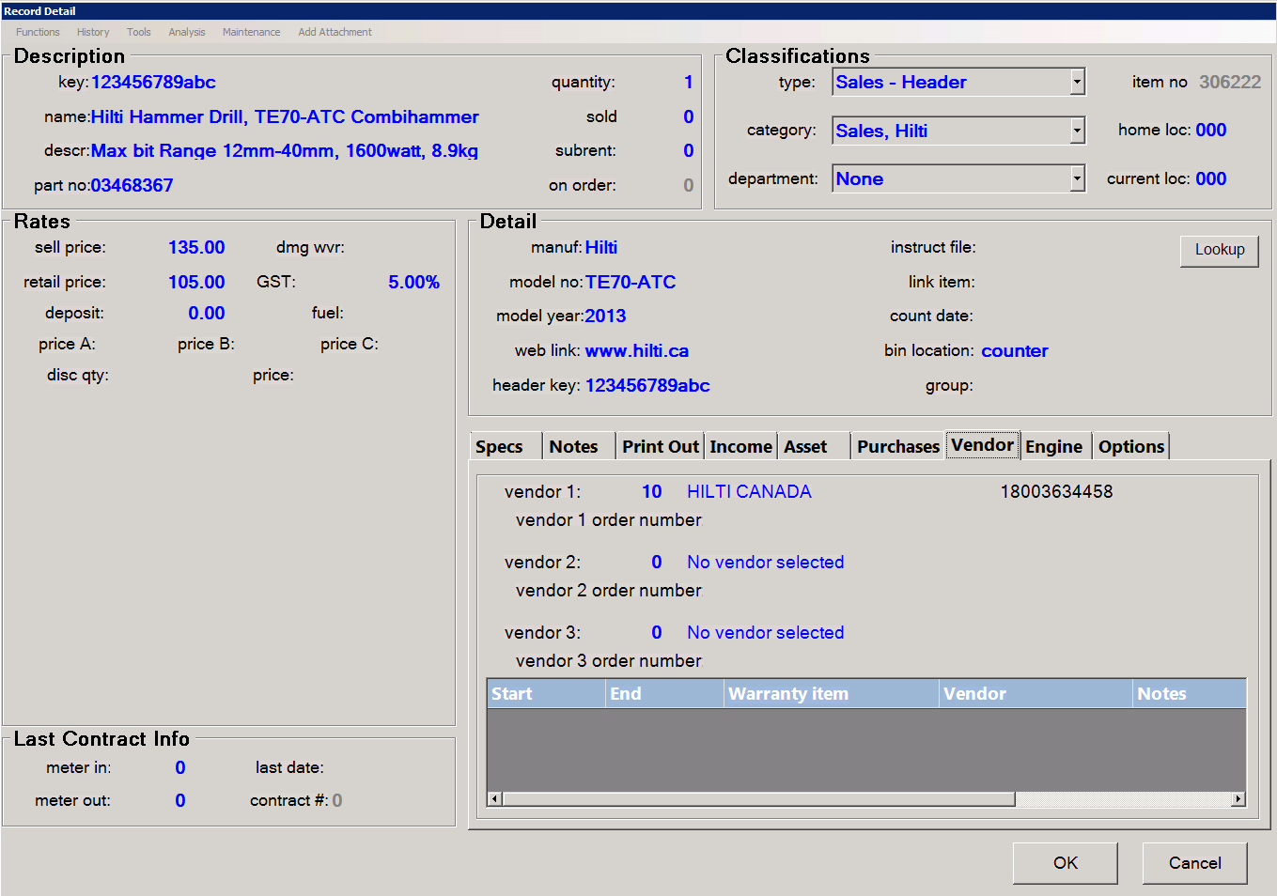
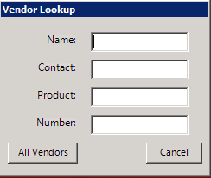
tabs
Purchases is for later reference
Vendor is the location for information on where we acquire our products. Use Vendor 1: as the primary source Vendor 2: as a backup place to purchase if available and Vendor 3: as the same. You may either type in the vendor number over the 0 or you may double click on the “No vendor selected” to bring up a vendor lookup box.
The Engine tab is used to store info on the engine of a sales item.

Slide 13
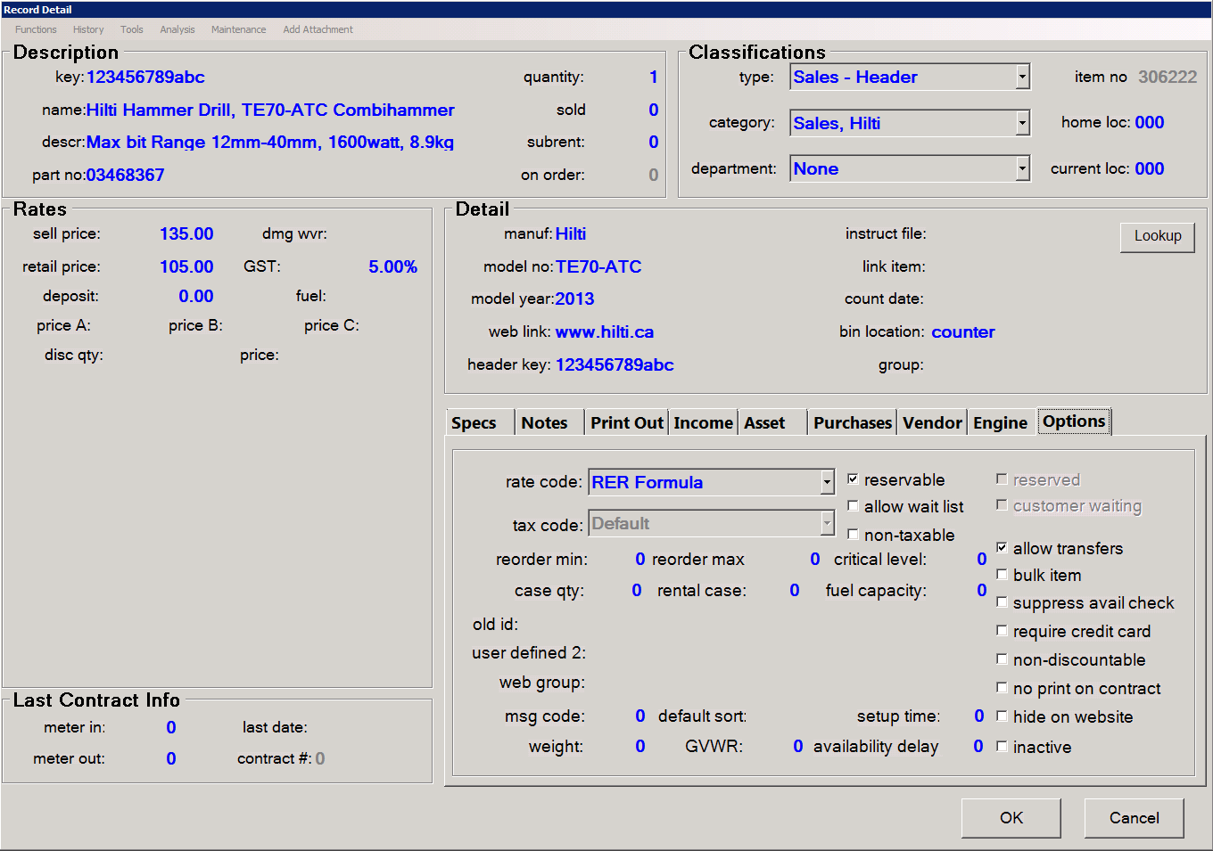
tabs
The Options tab contains reorder quantity's, Fuel Capacity, and other information on the item. Bulk item is for rentals, Suppress avail check stops warnings if you reach 0 quantity. Msg code: is unused as is default sort.

Slide 14
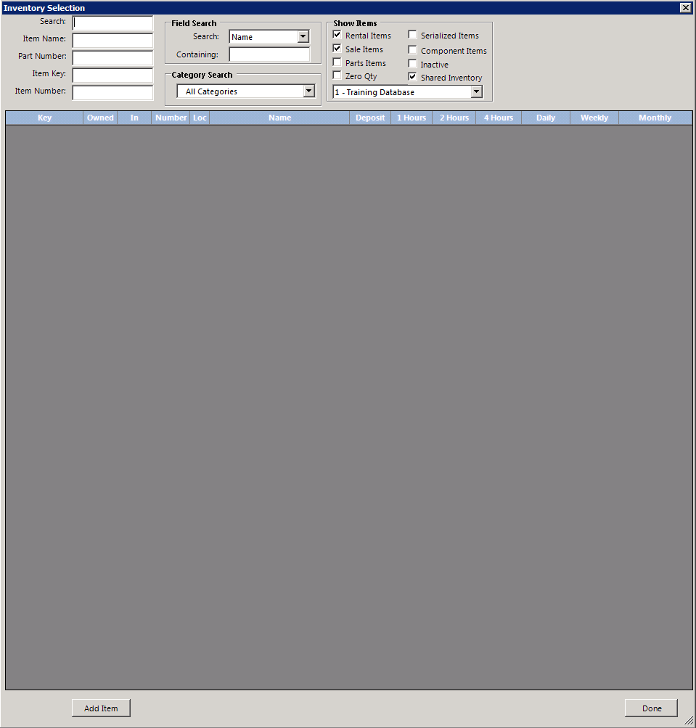
Finishing off
Click the ok button on the lower right of the screen once everything is filled in and it will return you to the Inventory selection screen.

Slide 15
You have completed this training session
If you have any questions please ask your manager before adding header items. And remember to practice using the training mode.

