Slide 1

Point of Rental Training
Please proceed at your own pace. Press the right arrow key to move though the training or left to go back, each slide will automatically advance after a few seconds.

Slide 2
item creation
sales items

Slide 3
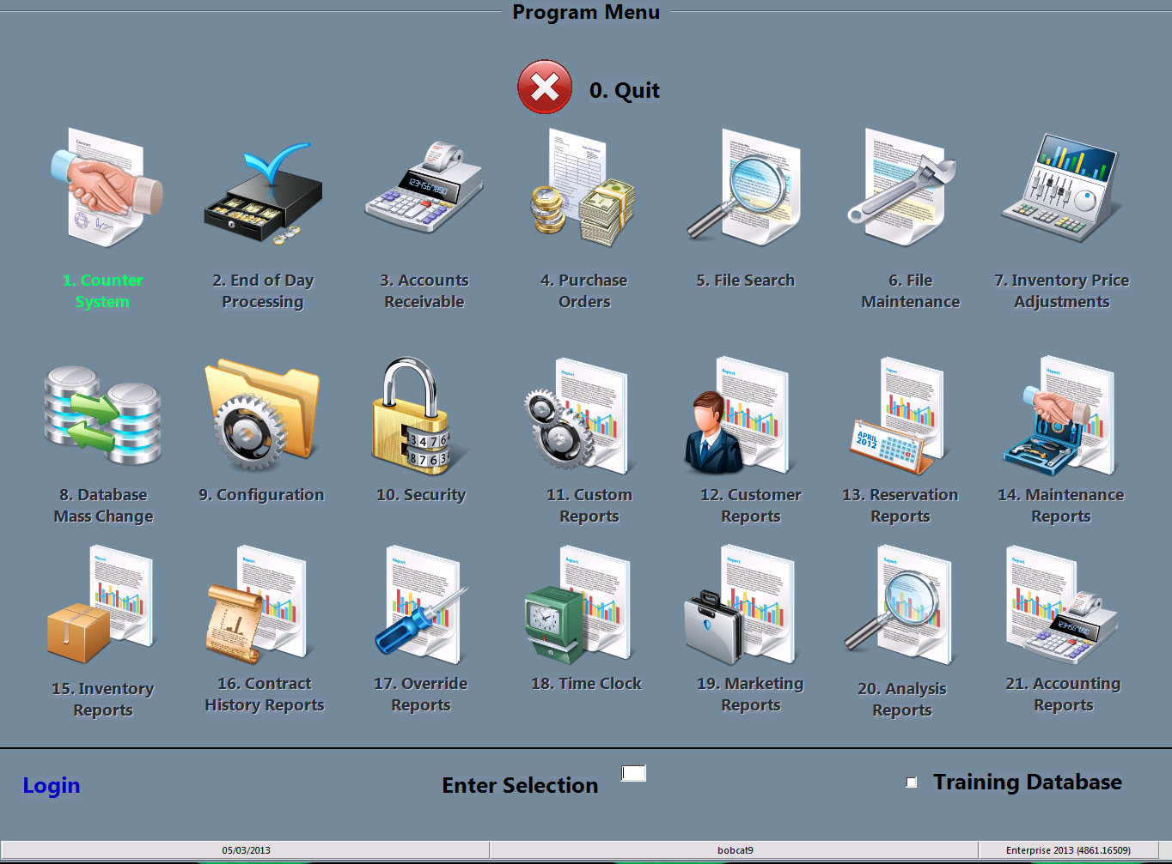
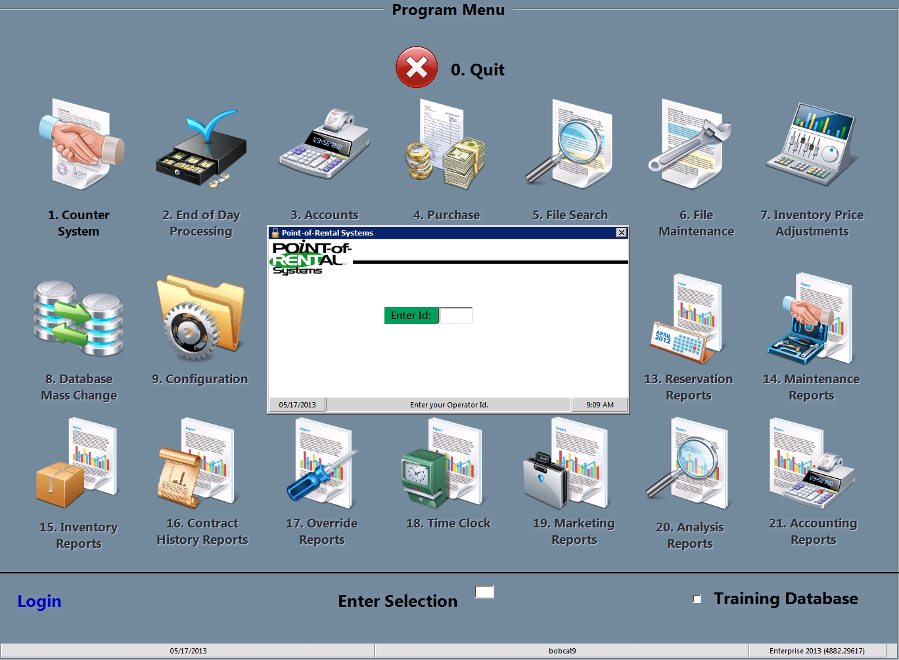
Select login
You must start by clicking the Login at the bottom left of the screen and typing in your password.

Slide 4
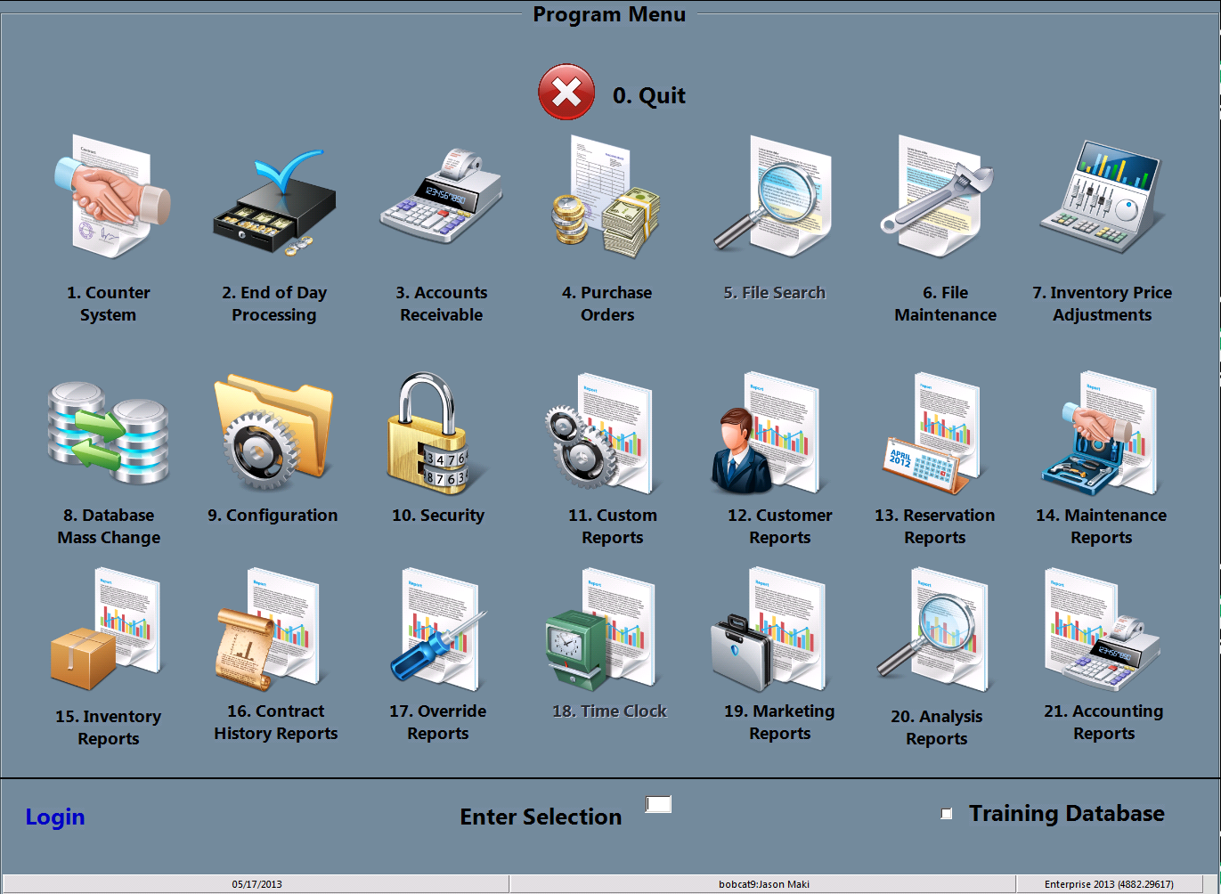
Select File maintenance
You may either double click the File Maintenance icon or type the #6 in the “Enter Selection” space then press enter

Slide 5
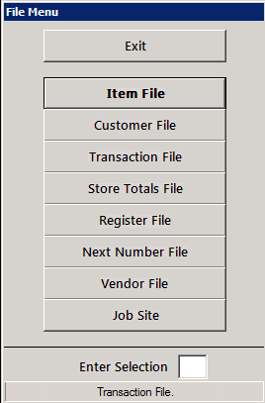
Select item file
You may either double click the item file icon or type the #1 in the “Enter Selection” space then press enter

Slide 6
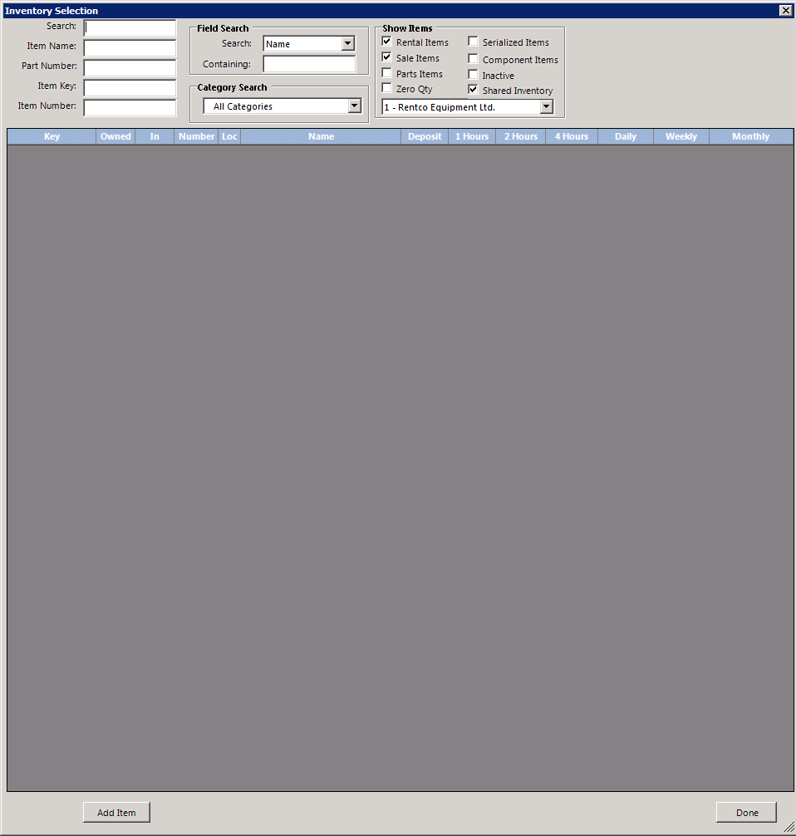
Enter item header key
You may enter the Header key in the item key : slot or search for a header using one of the other fields available

Slide 7
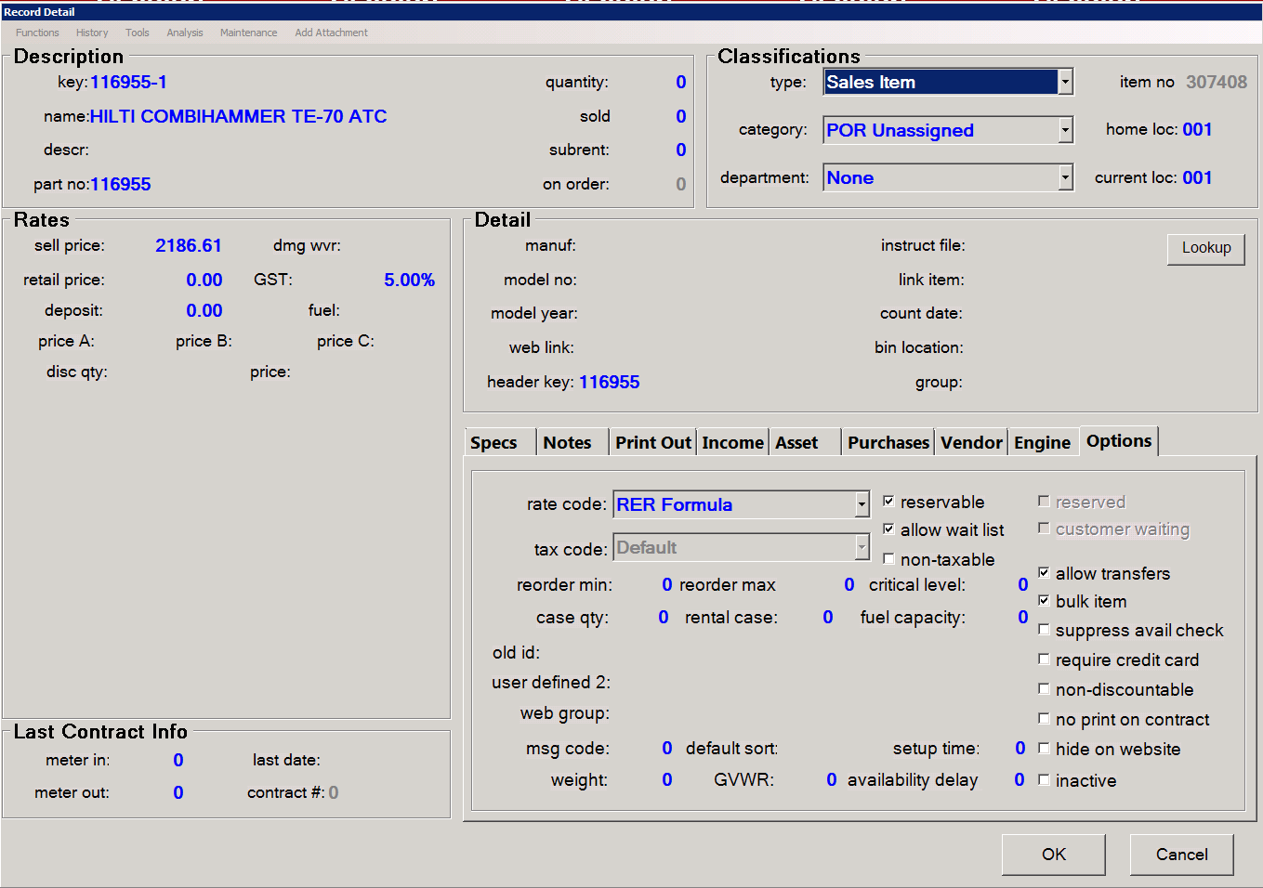
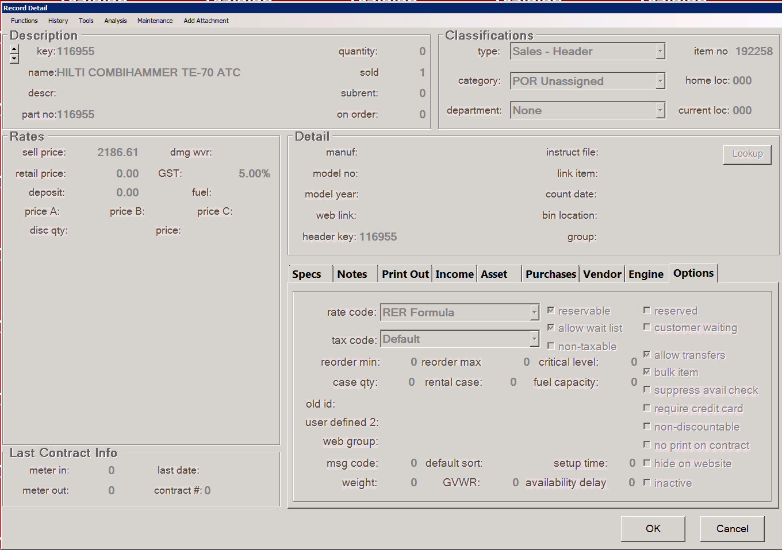
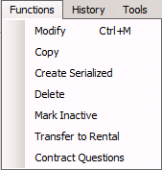
Create a new item
You may now click the Functions drop down menu and select Copy. This will create a duplicate of the header with your store number at the end of the number. You may edit your item key along with any other data you wish to change ie bin Location and purchase price. (you must change the home and current locations)

Slide 8
Create a new item
Once all data has been filled in and everything is checked for correctness simply click ok and the item will be ready.
Insure you have filled in as much information as possible as it will help you later!!

Slide 9
You have completed this training session
If you have any questions please ask your manager before adding sales items. And remember to practice using the training mode.

