Slide 1

Point of Rental Training
Please proceed at your own pace. Press the right arrow key to move though the training or left to go back, each slide will automatically advance after a few seconds.

Slide 2
Rental item creation
From a sales item

Slide 3
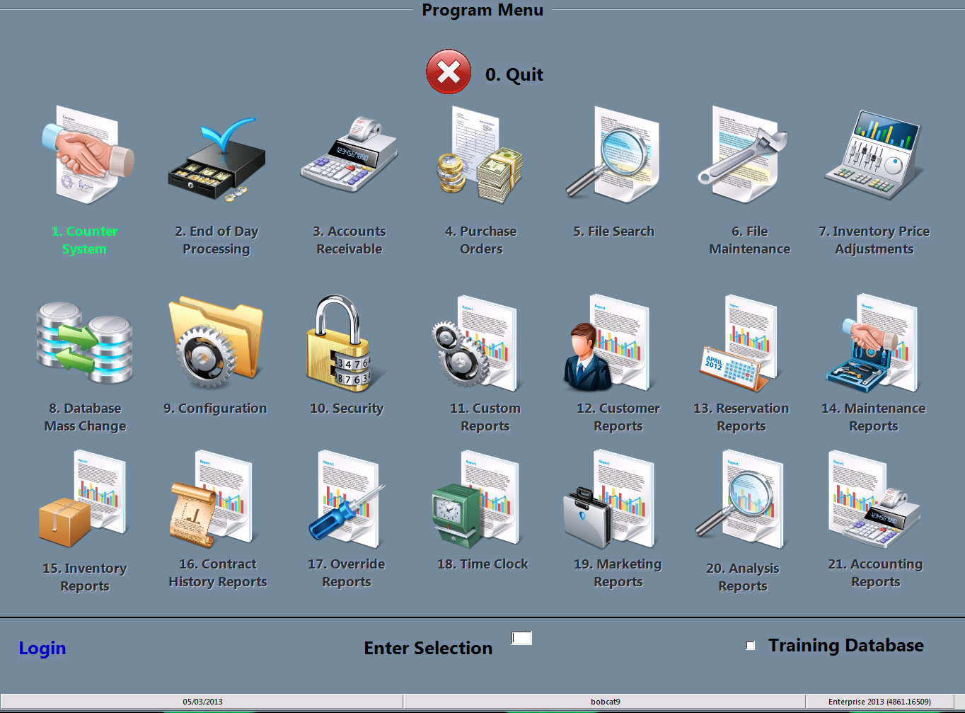
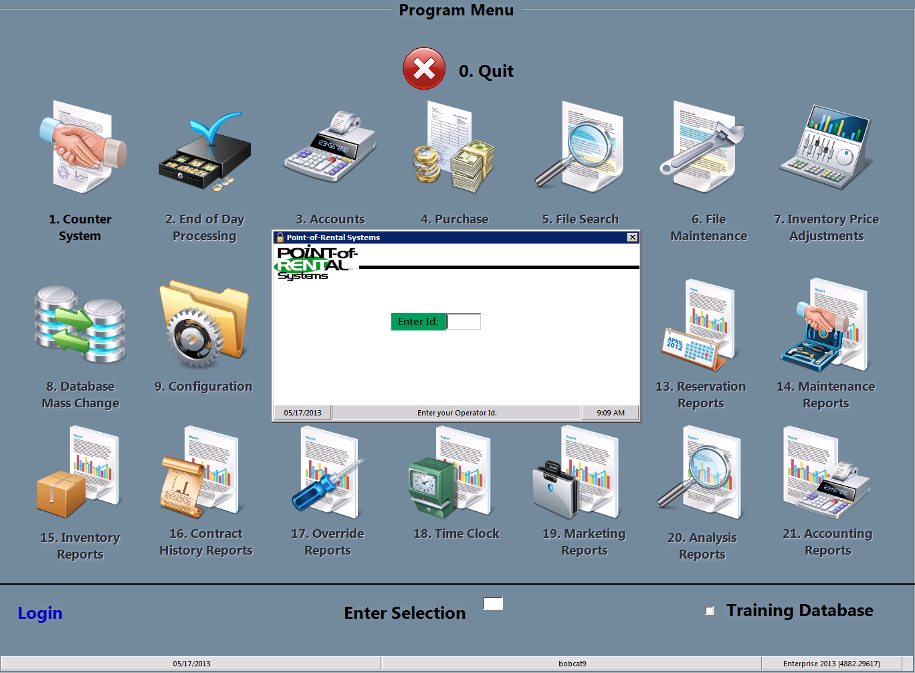
Select login
You must start by clicking the Login at the bottom left of the screen and typing in your password.

Slide 4
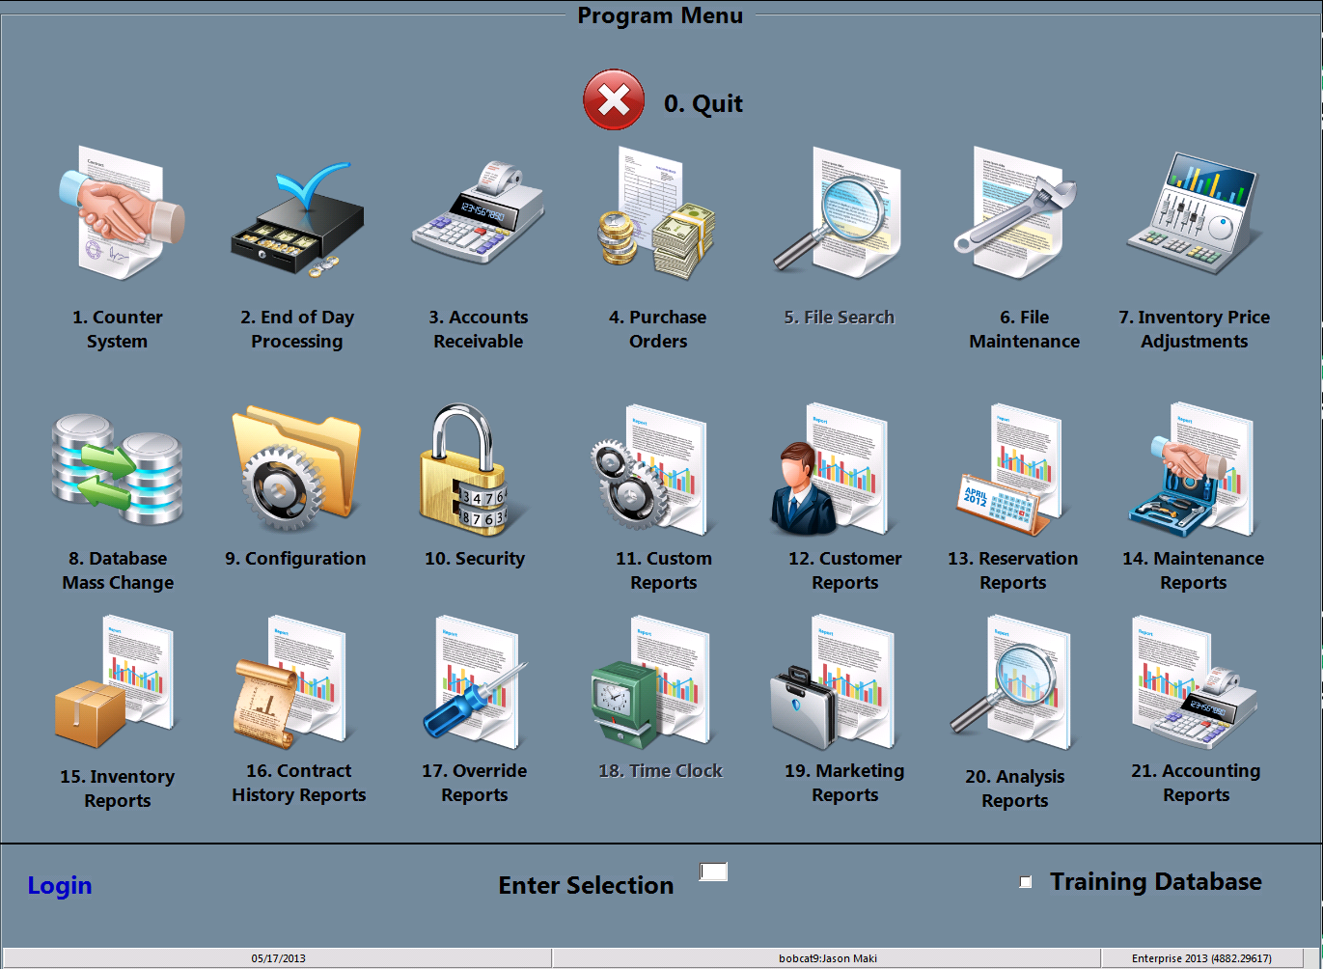
Select File maintenance
You may either double click the File Maintenance icon or type the #6 in the “Enter Selection” space then press enter

Slide 5
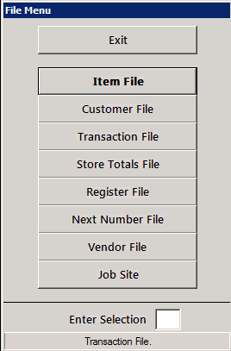
Select item file
You may either double click the item file icon or type the #1 in the “Enter Selection” space then press enter

Slide 6
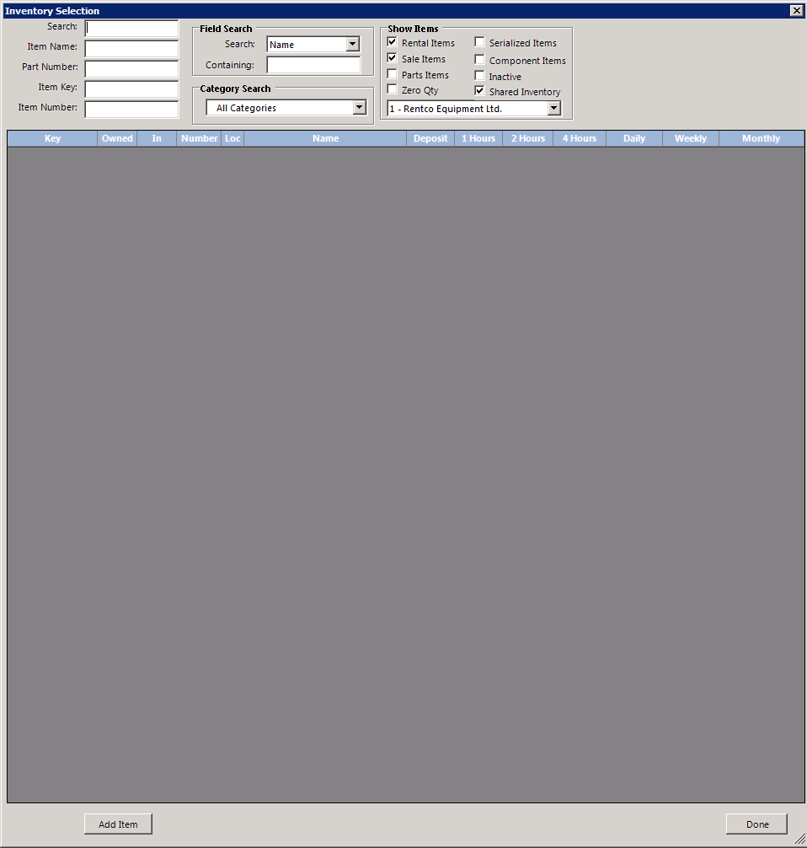
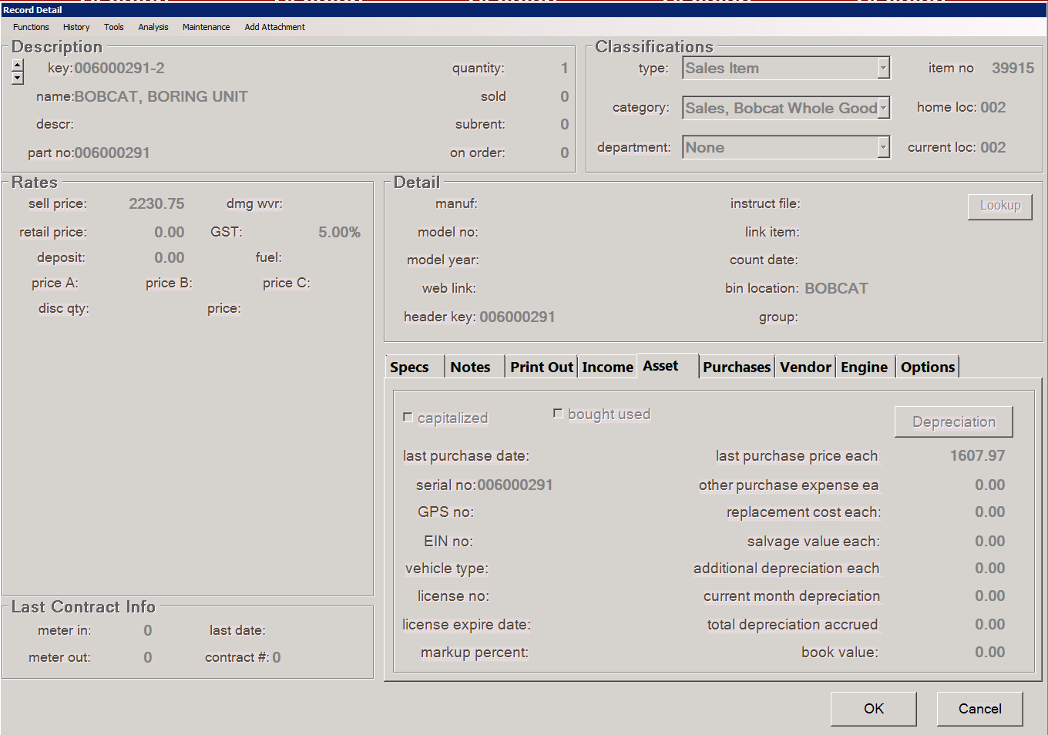
Enter Sales item key
You may enter the item key in the item key: slot or search for an item using one of the other fields available

Slide 7
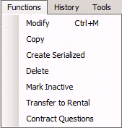
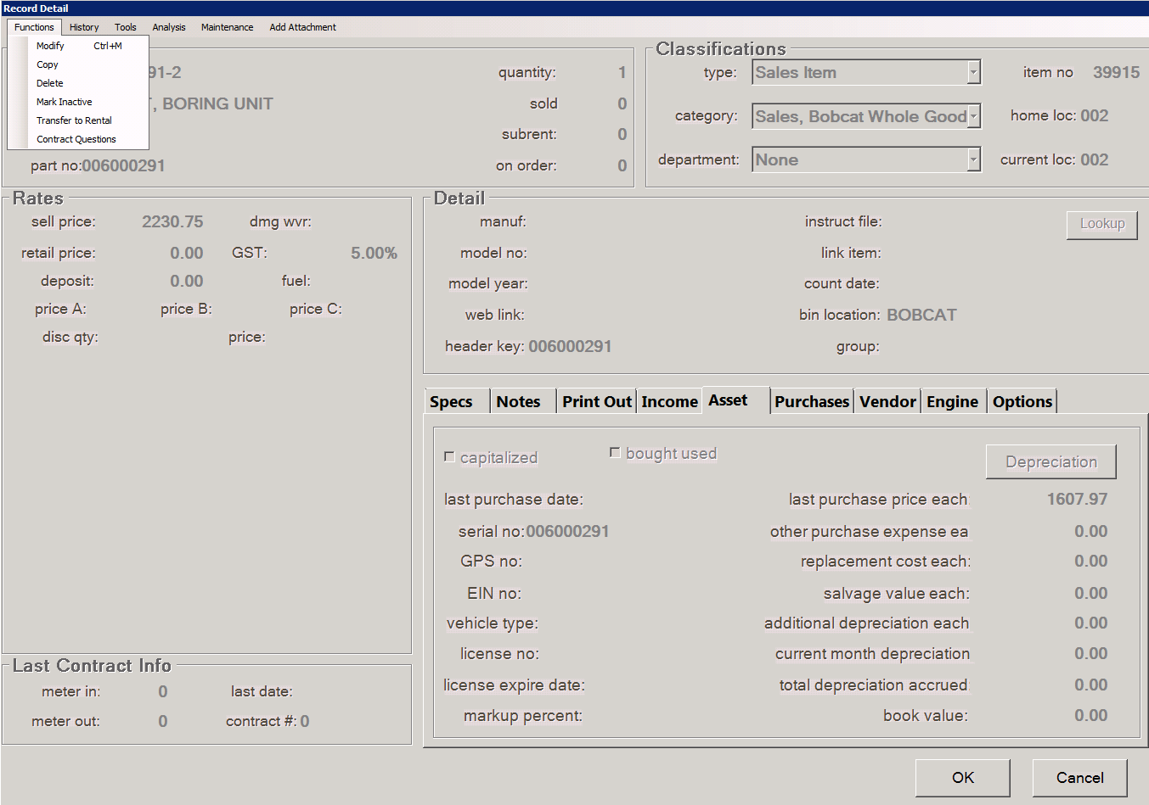
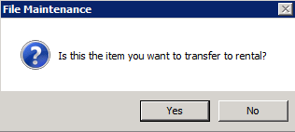
Create a new item
You may now click the Functions drop down menu and select Transfer to Rental. Select yes when asked if this is the item you want to transfer (if it is). If it is a Serialized rental item (0000#00000) select create new rental item record, if it is a multi number (0000#00m) select no.

Slide 8
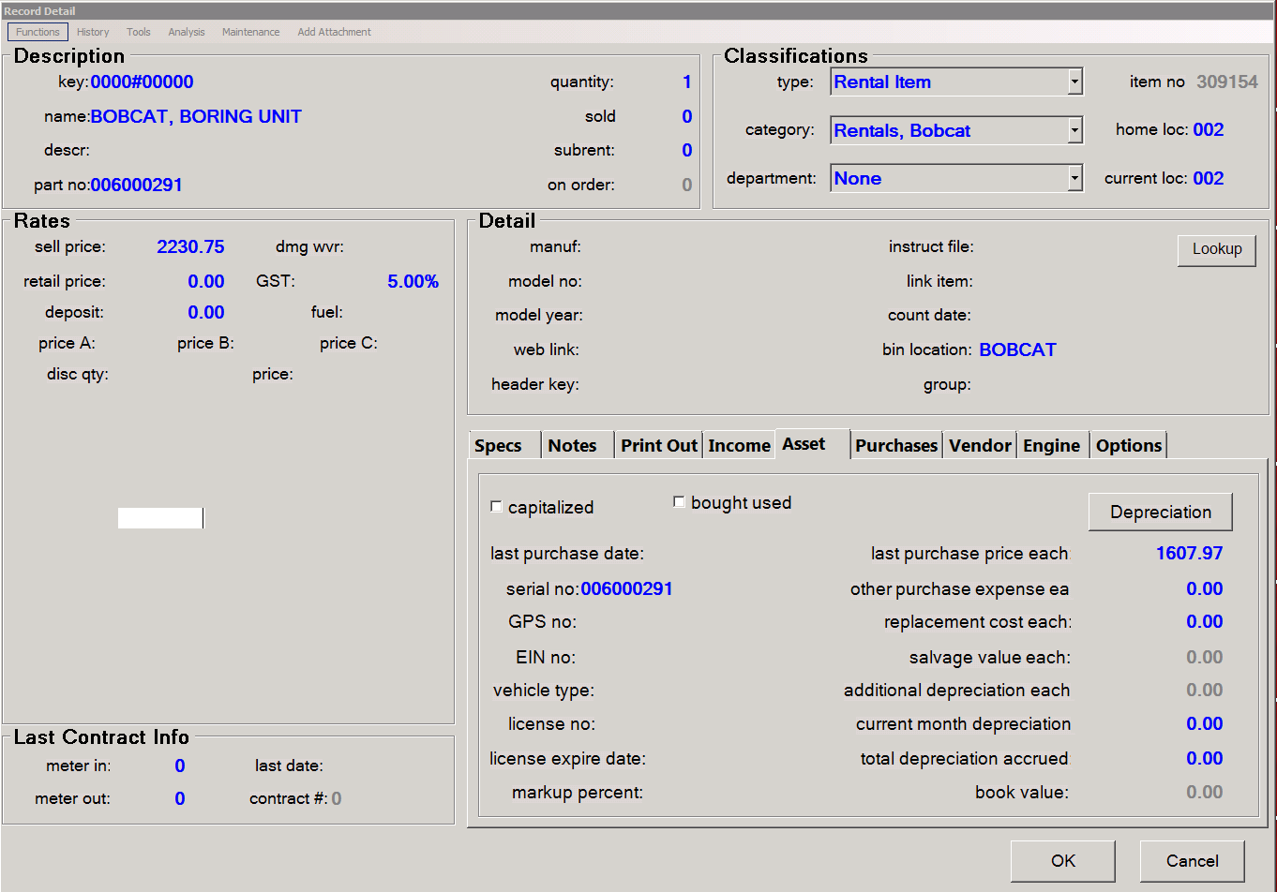
Create a new item
Enter the units rental number (0000#00000) and fill in all relevant data in all fields. Once all data has been filled in and everything is checked for correctness simply click ok and the item will be ready to rent.
Insure you have filled in as much information as possible as it will help you later!! Notes are very useful to remind staff to include or suggest items and Print outs are helpful to customers. Be sure to add header key and to change the category. If there is no header refer to header creation training.

Slide 9
You have completed this training session
If you have any questions please ask your manager before adding sales items. And remember to practice using the training mode.

