Slide 1

Point of Rental Training
Please proceed at your own pace. Press the right arrow key to move though the training or left to go back, each slide will automatically advance after a few seconds.

Slide 2
Contract creation
Using a cash account

Slide 3
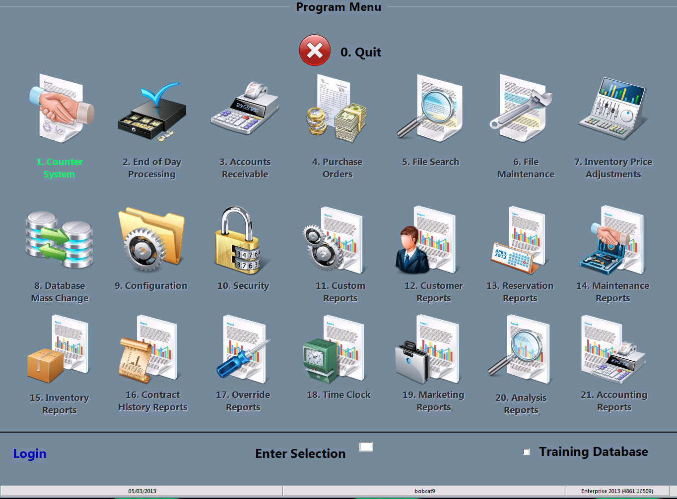
Select counter system
You may either double click the 1.Counter System icon or type the #1 in the “Enter Selection” space then press enter

Slide 4
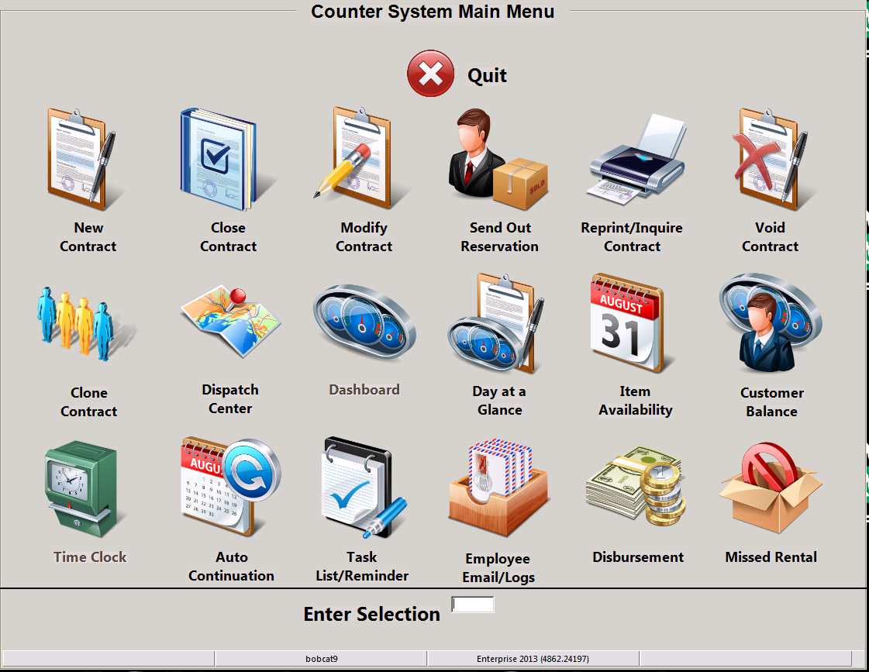
Select new contract
You may either double click the New Contract icon or type the #1 in the “Enter Selection” space then press enter

Slide 5
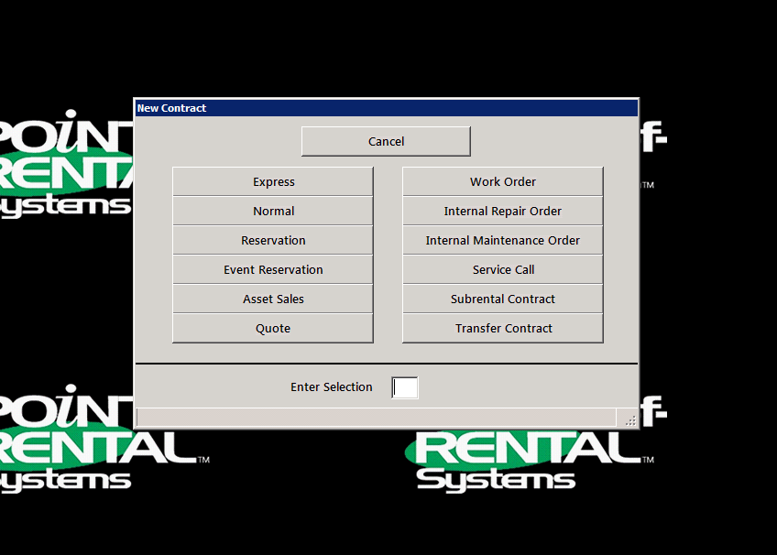
Select normal
You may either double click the Normal icon or type the #2 in the “Enter Selection” space then press enter

Slide 6
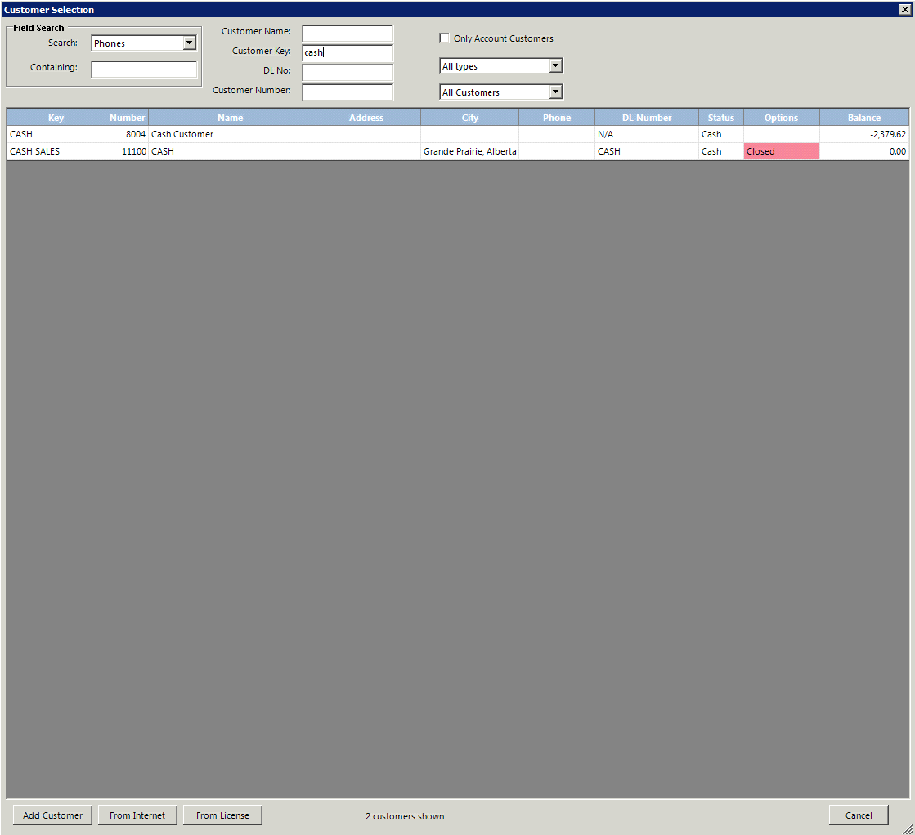
Select customer
You may type the customers name in the Customer Name: slot, type in the customer key in the Customer Key: slot or search using one of the various search criteria provided in the Search: drop menu. If it is a new customer you can select Add Customer or From license. If it is a sales contract you can use the customer key “cash” this account must not be edited.

Slide 7
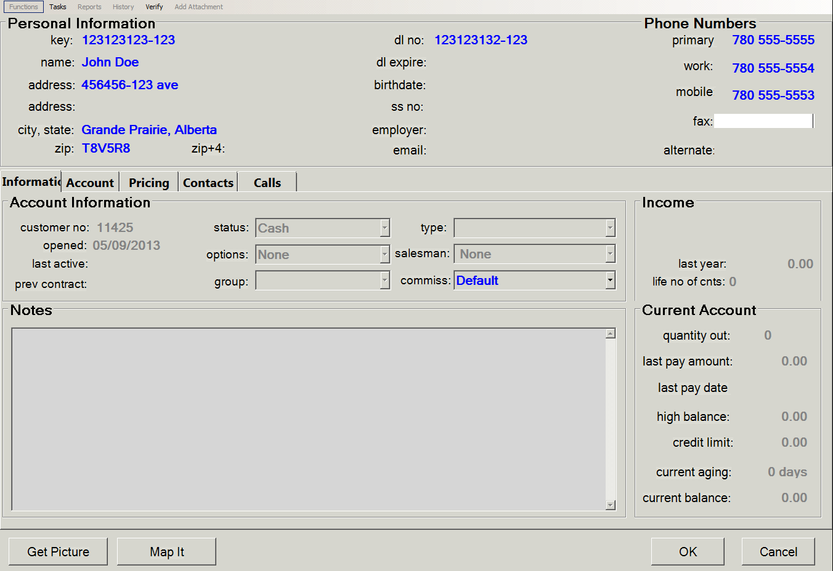
Add Customer
If you select Add Customer you will have to manually enter all the customer information. While creating the account use the customers drivers license as the key.
Once information has been verified click ok

Slide 8
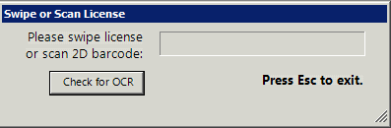
From License
If you select From License you will simply have to insert the customers drivers license into the card scanner face down with the top edge facing the scanner. The program should extract all the required data from the license and enter it into Point of Rentals, you will still need to gather phone numbers and check that the data transferred correctly.
Once the data has all been verified you may now click ok to continue

Slide 9
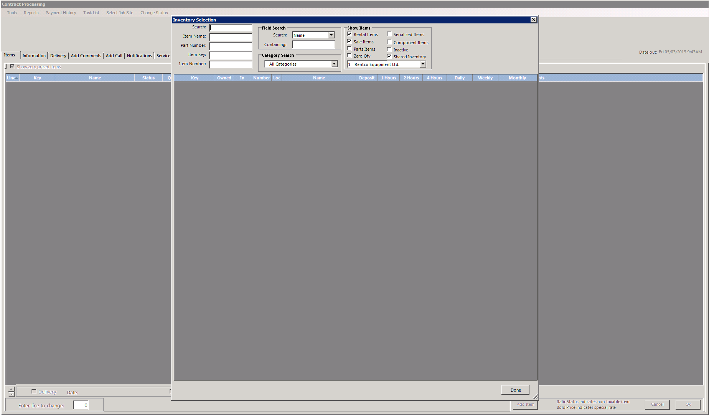
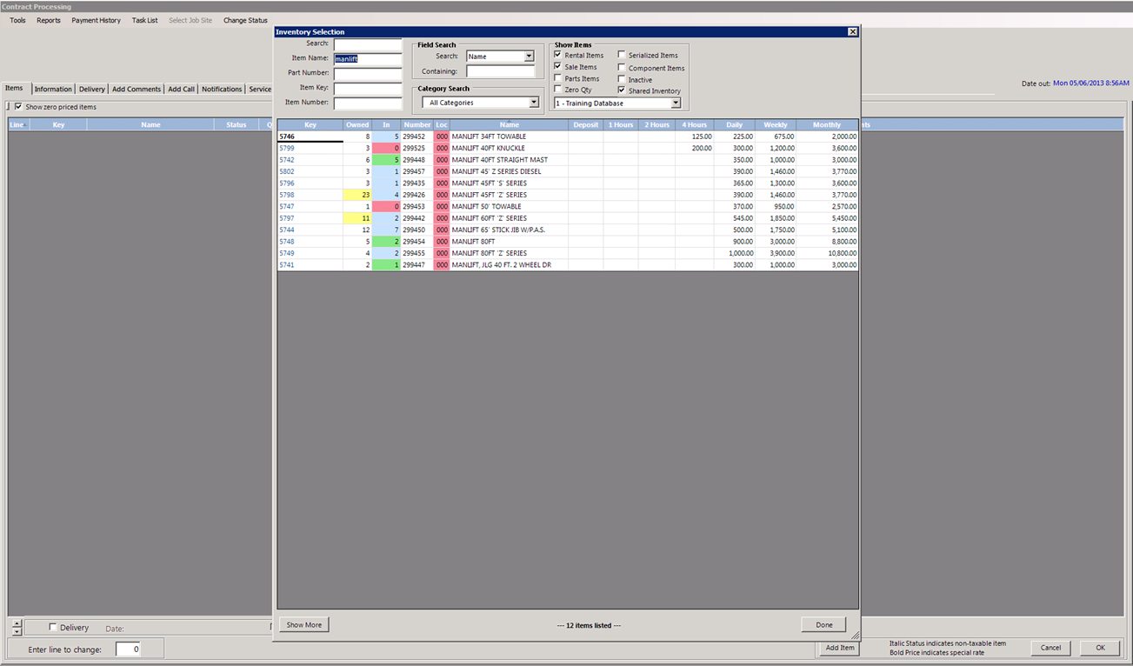
Select item
You may search by item name, item key, or any of the other search criteria. You must insure your are selecting items from your locations by clicking your location in the drop down menu situated under the Show Items section. You may also narrow your search by eliminating unnecessary fields such as Sales Items if your looking for rental items

Slide 10
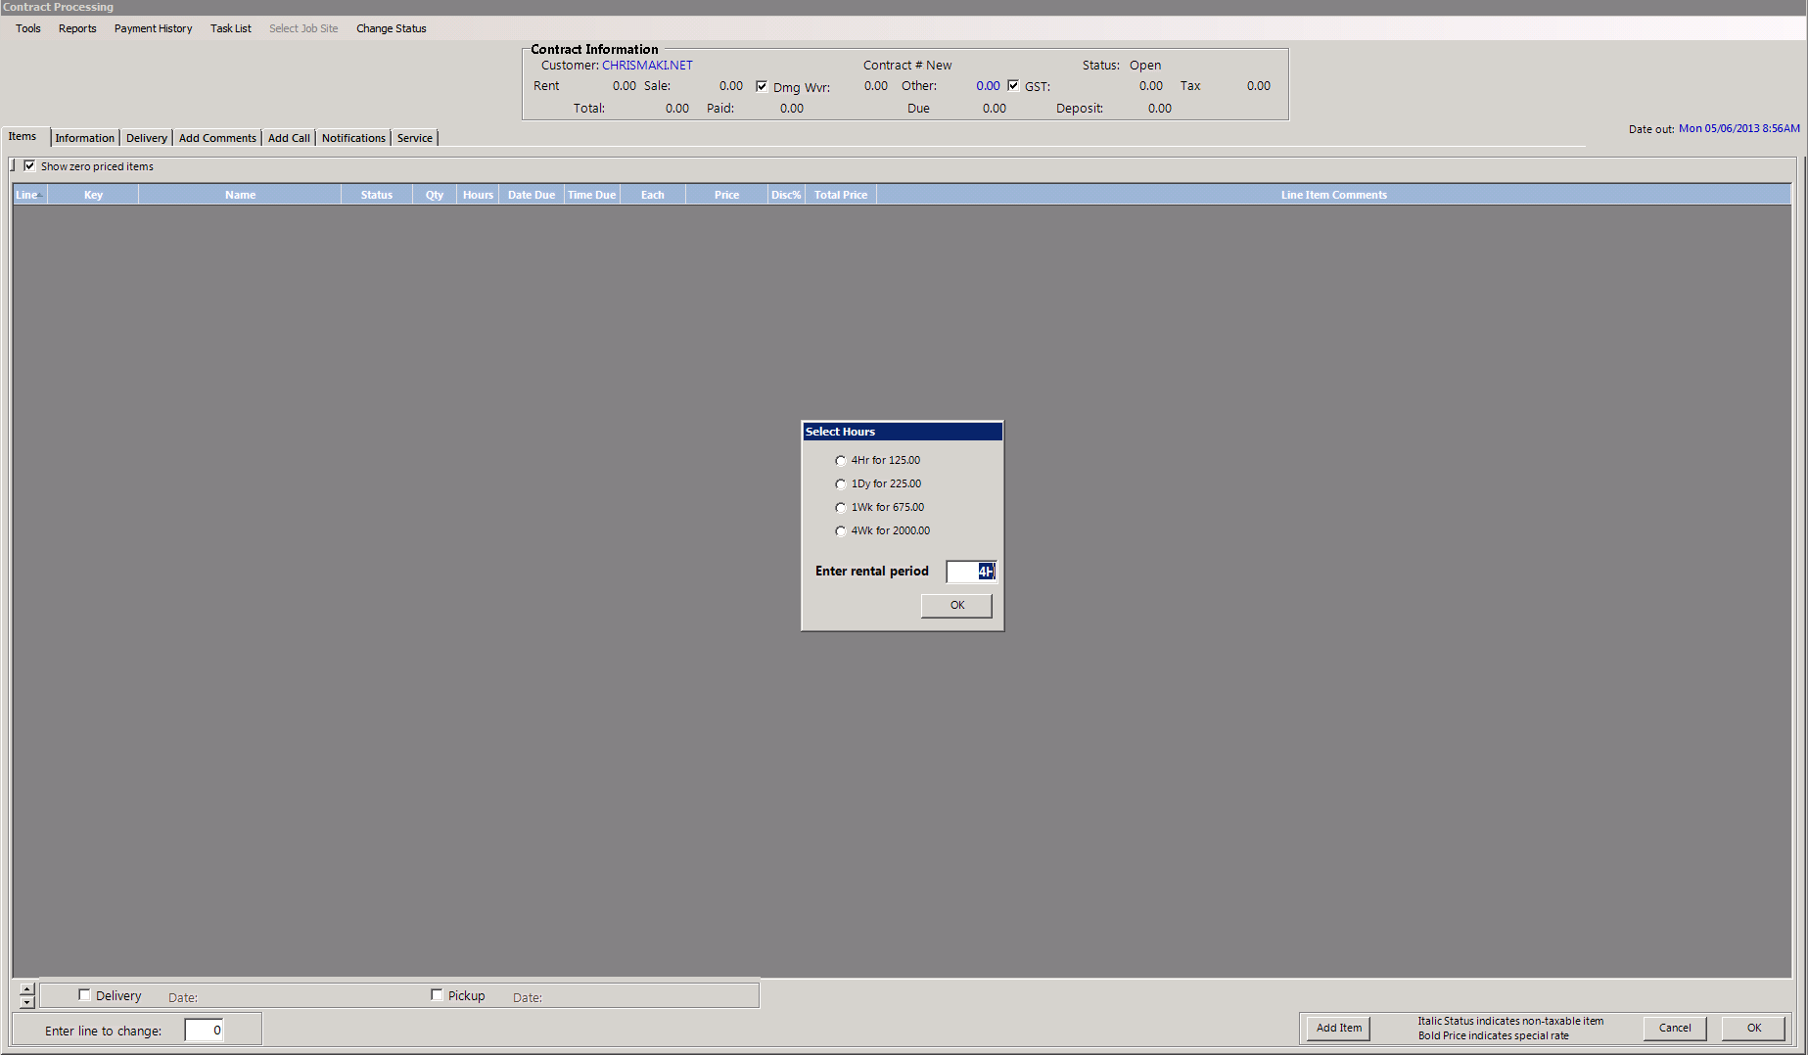
Select rental length
You will be given the option to pick any of the rental lengths that item has been setup with. If the customer is unsure how long they would like to keep the item use their best guess, if they still don’t know enter one day

Slide 11
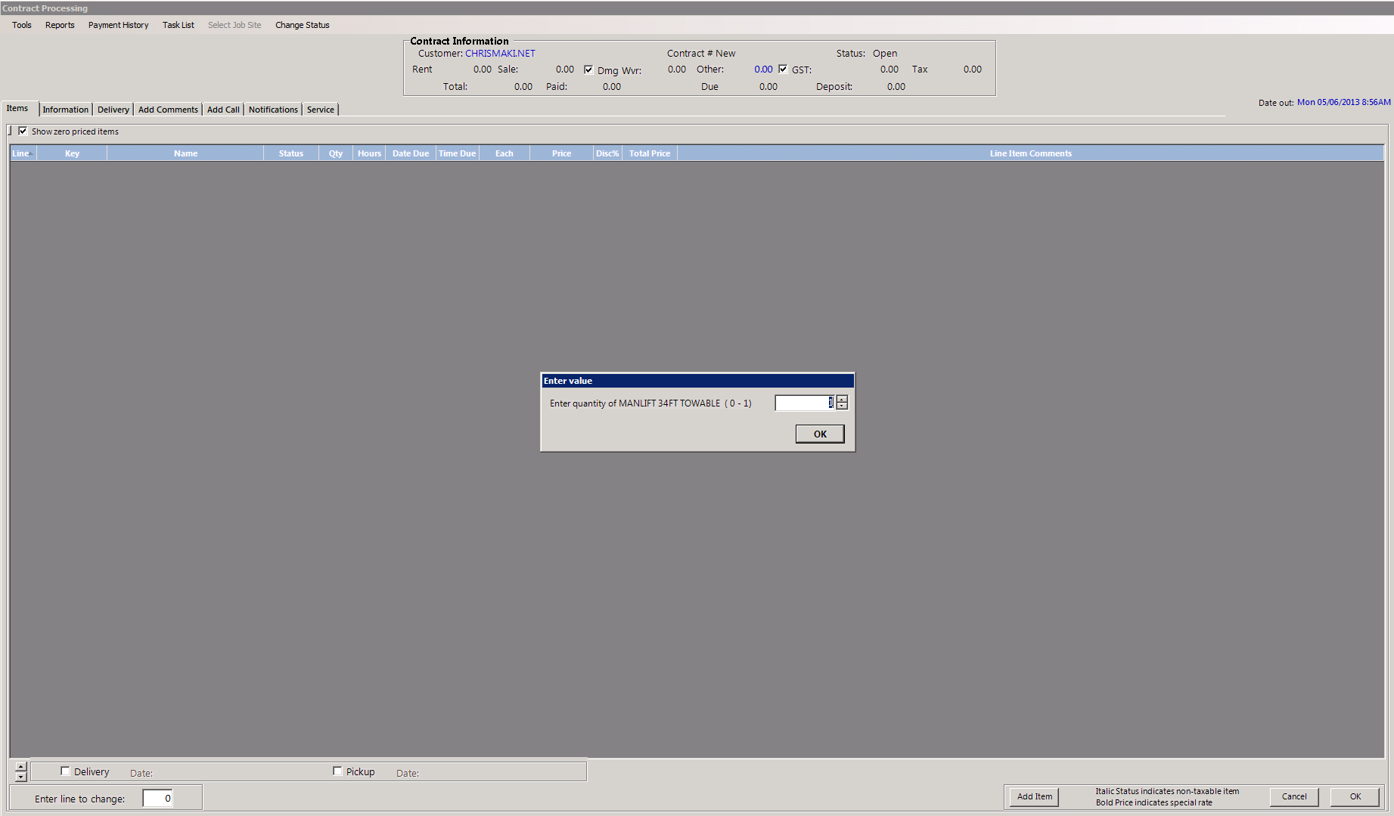
Select rental quantity
You will be given the option to pick the quantity of your selected item, if it is a multi item you may pick as many as are available to rent, if it is a serialized item you will only be able to pick one.

Slide 12
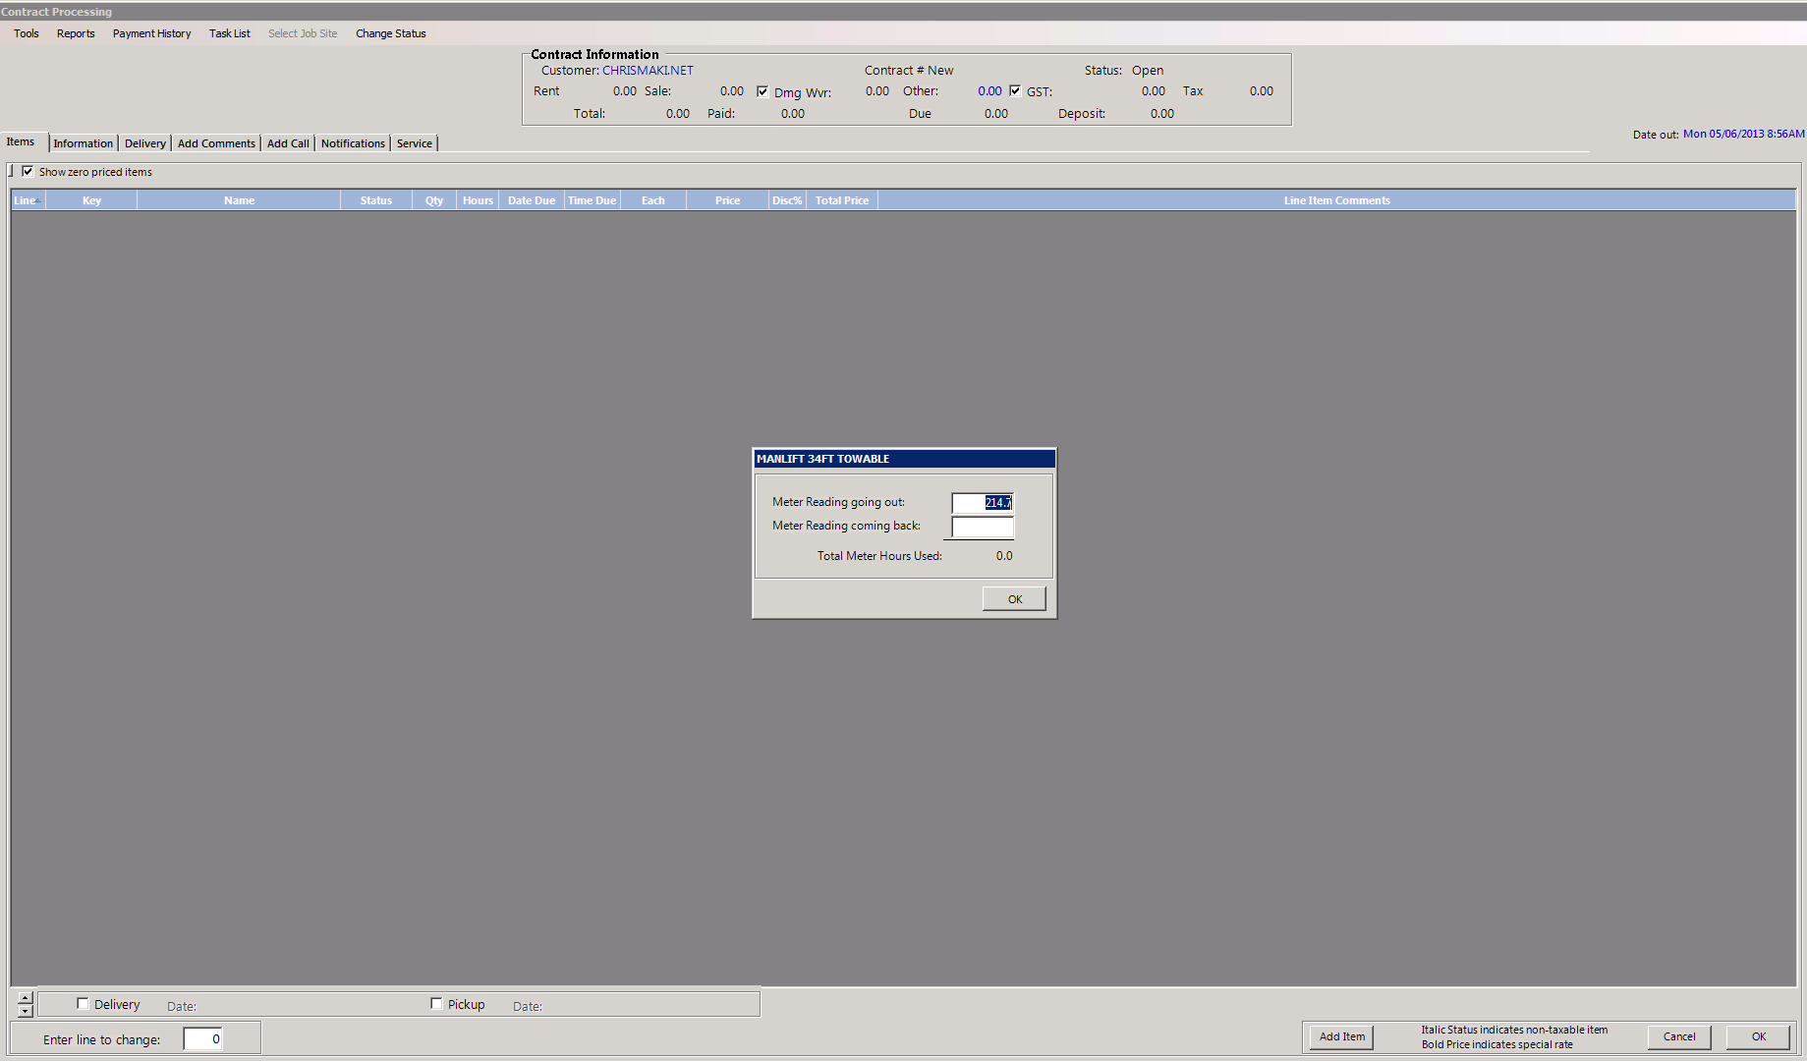
Input your hour meter
If the item has an hour meter, input the value in the going out slot provided, confirm with a visual inspection that this value is correct

Slide 13
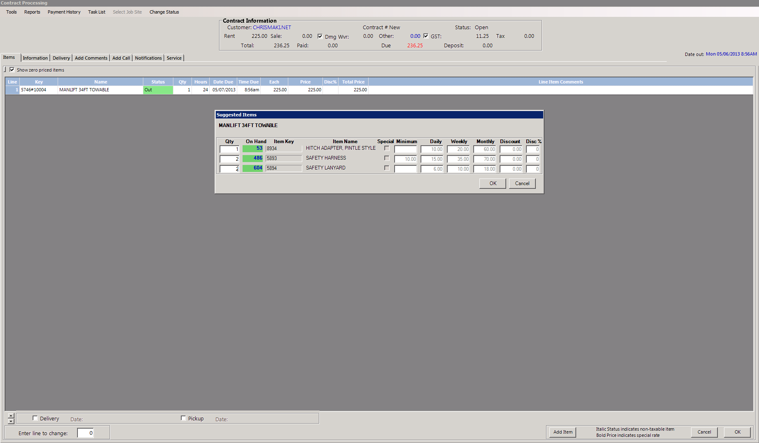
Suggested items
If the item has been created with a list of suggested items they will appear now giving you the option to select them. please note if it is a serialized item (has a unit number 0000#00000) you may only add one of each. If it is a multi number (has a unit number 0000m-1) you may add as many as are available.

Slide 14
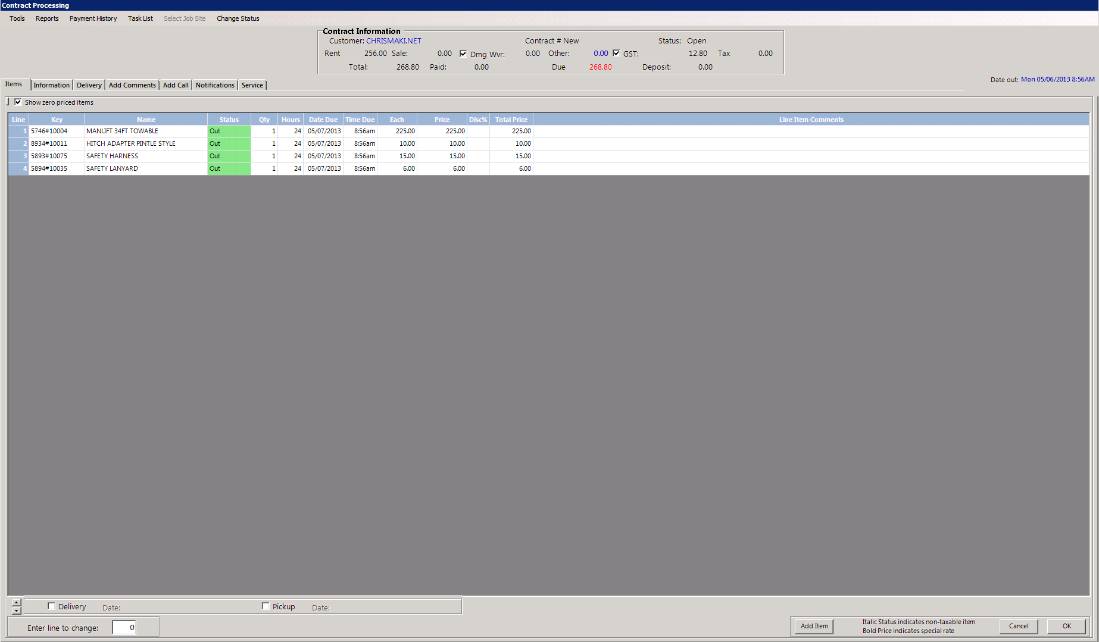
Additional items
You may now continue to add additional items to the contract as required. These may be rental items or sales items. Simply follow the previous step until all items are added.

Slide 15
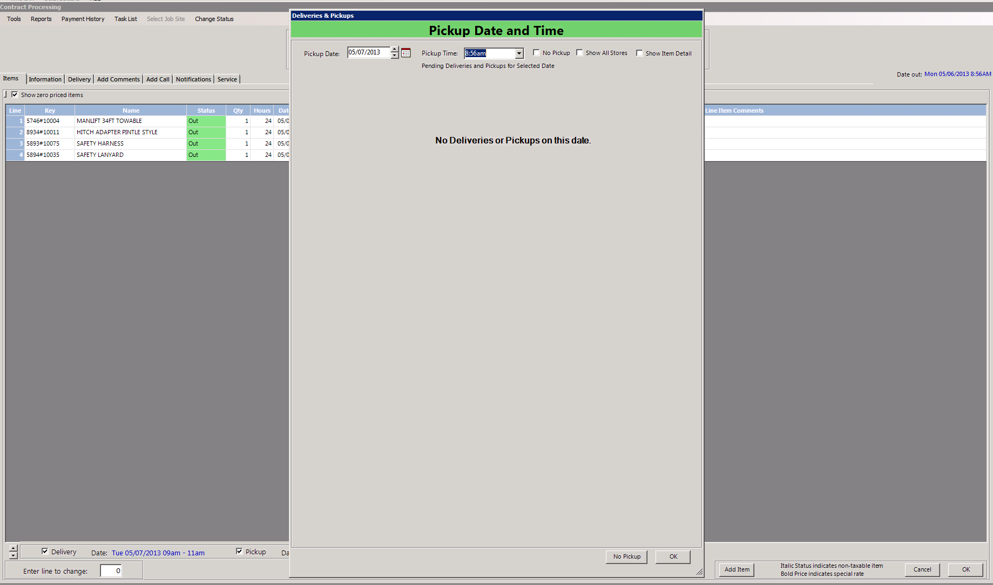
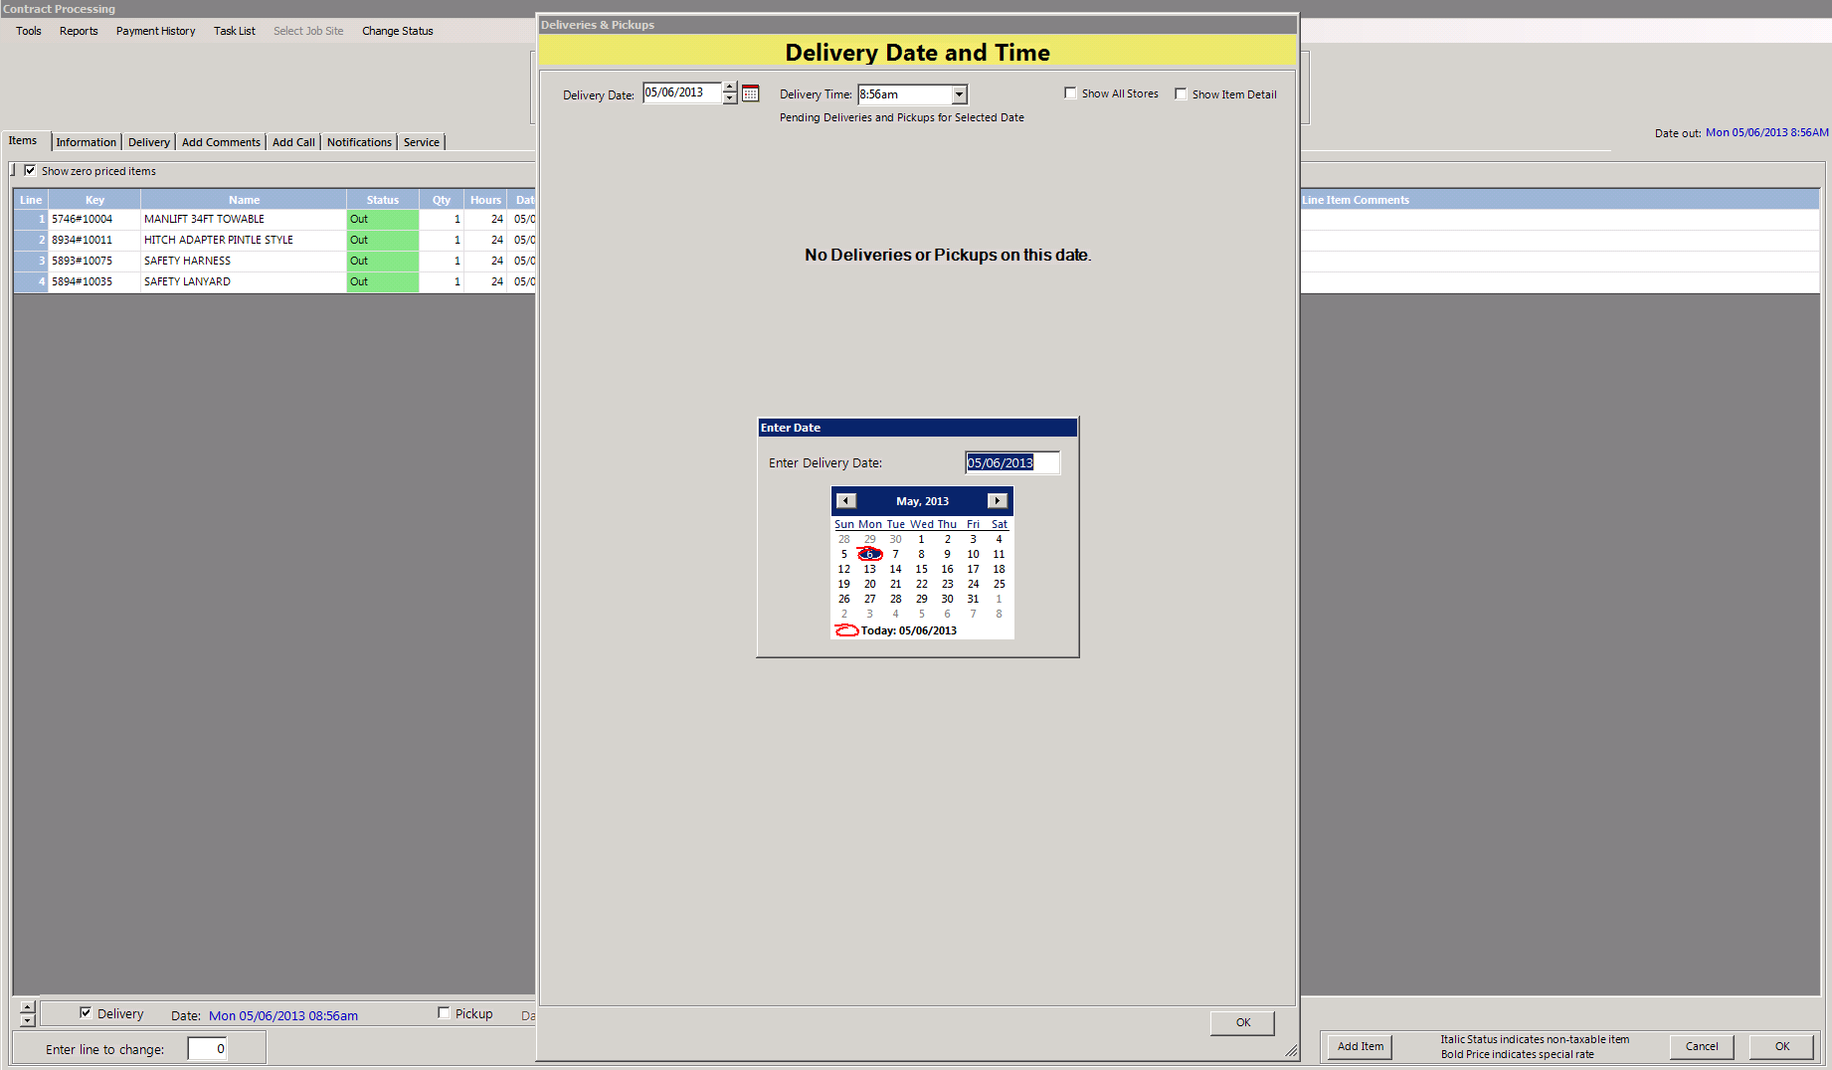
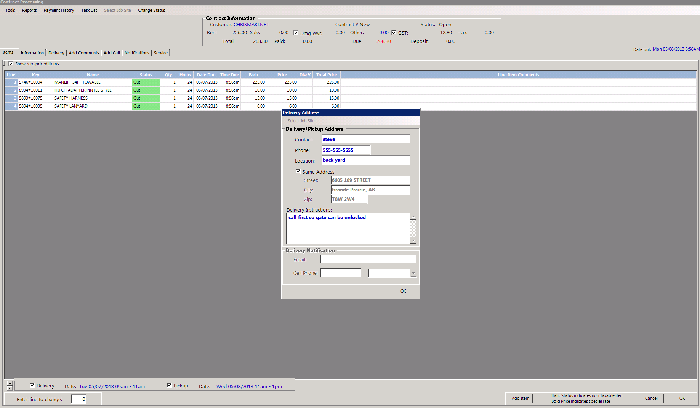
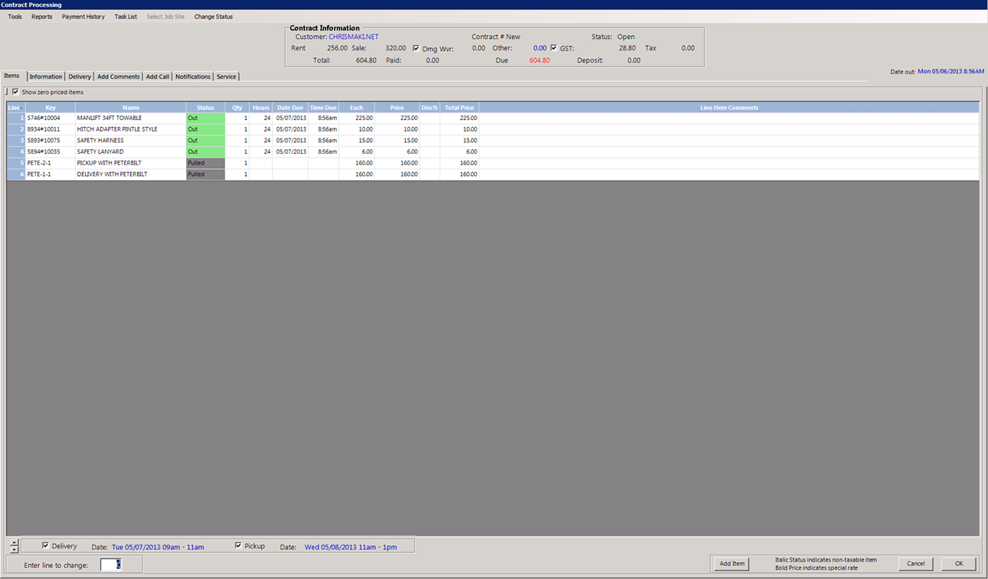
Setting delivery
If delivery is required you can select it at the bottom left corner by clicking on the check box. You will then be prompted to select the time and date and enter your delivery location. Your delivery time should only be set if you know when the driver is available. Please be aware this only books delivery and pick up, you must charge for it by adding the proper delivery charge using the item key required.

Slide 16
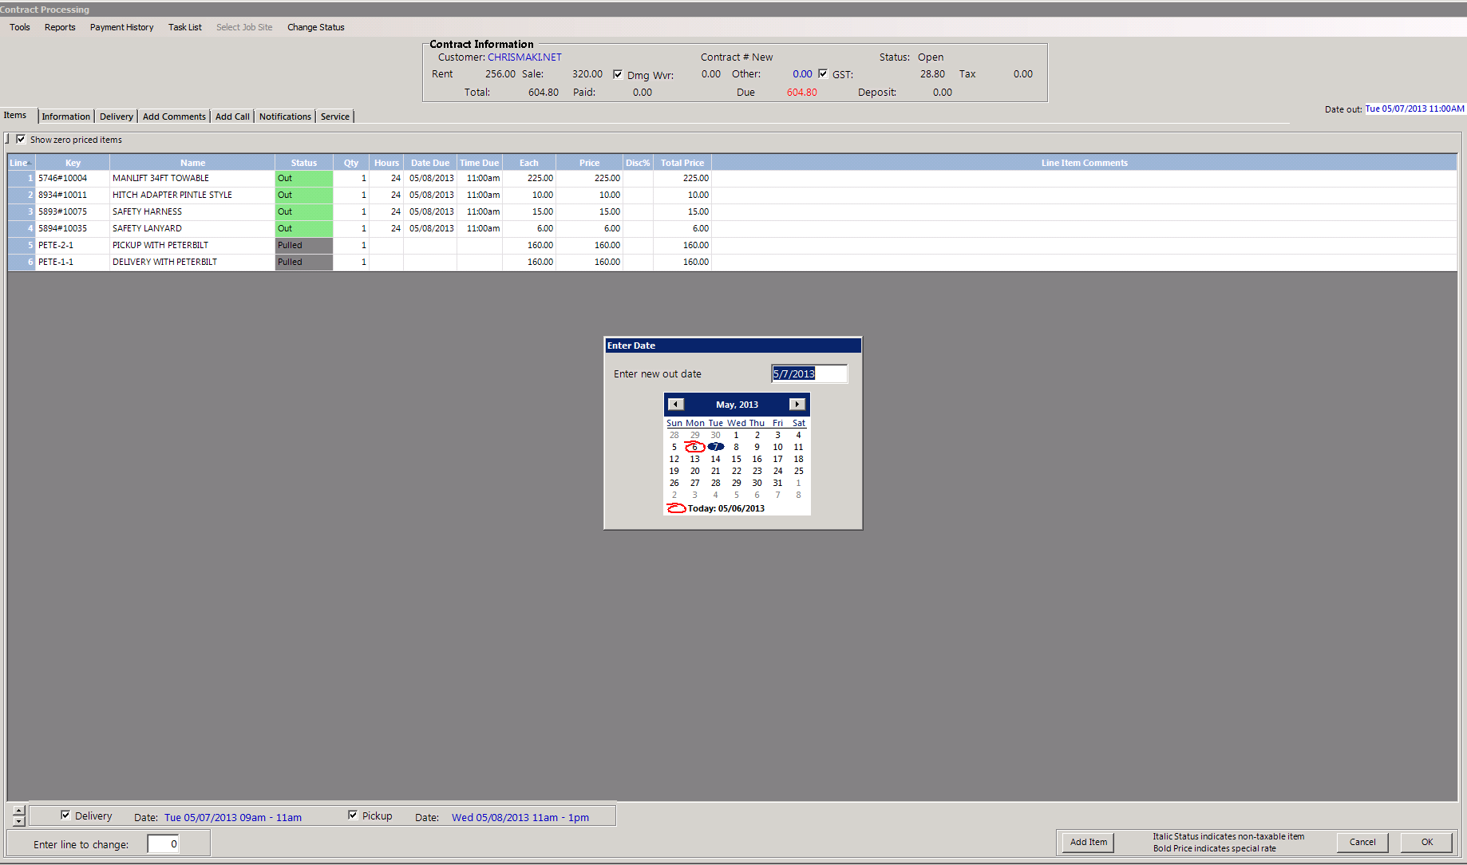
Time and date out
You may on occasion need to adjust the time out to reflect delivery time or other reasons. This can be accomplished by clicking the date out in the upper right of the screen. The time out can not be before the delivery time.

Slide 17
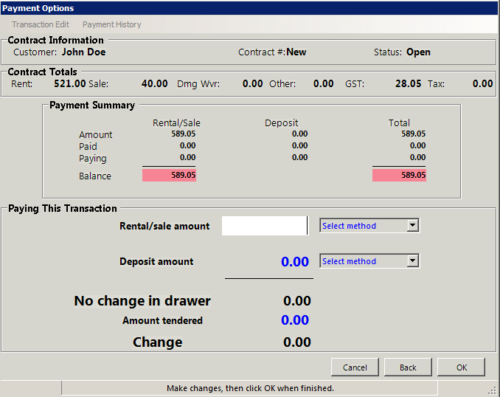
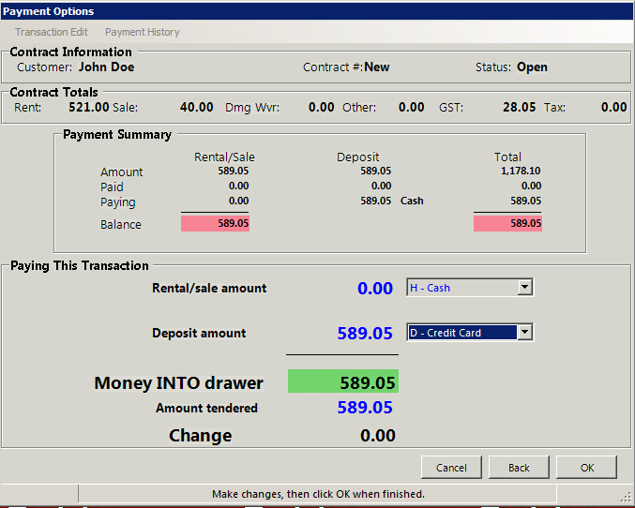
Finishing off
On cash accounts deposits and prepayments are required. At this point you must input the amount you will be taking as a deposit, this is generally the amount of the rental plus any sales items. If your unsure how much of a deposit is required ask your manager. To enter a deposit select cash on the drop down menu for rentals/sales then in the line below select how they will pay the deposit in the Deposit drop down menu and finally enter the required amount. Now simply click ok. It will then ask you if you would like to print, email or view on the screen, note that faxing from this screen is currently unavailable.

Slide 18
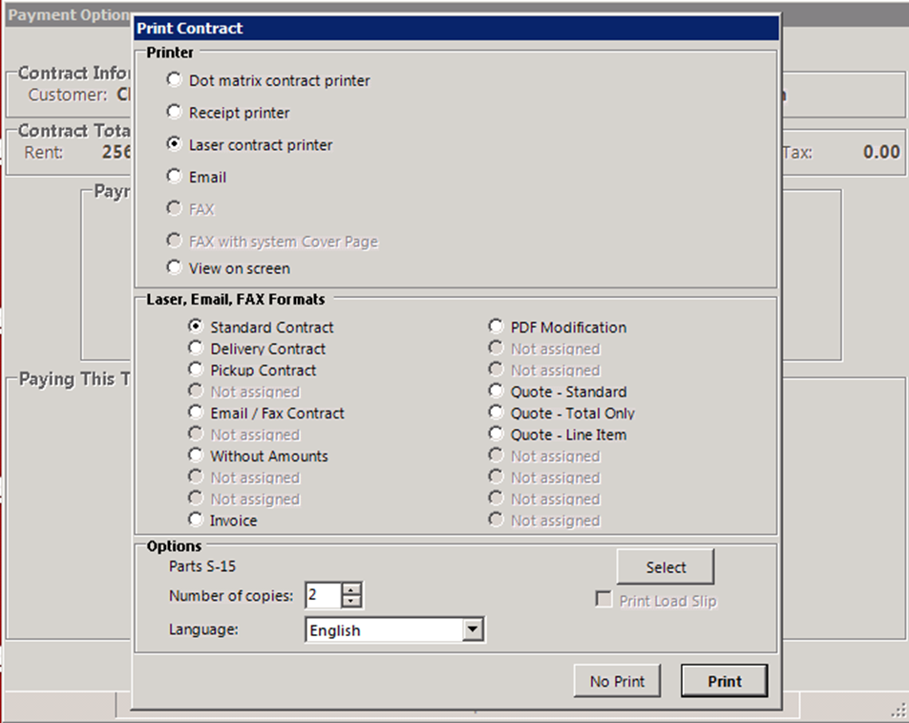
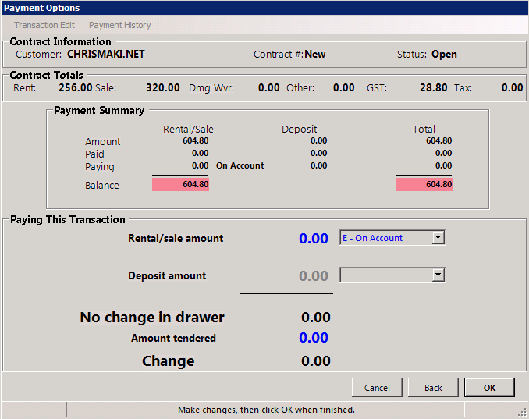
Finishing off
Once you say ok you will go to the printing screen, It will then ask you if you would like to print, email or view on the screen, note that faxing from this screen is currently unavailable. Click print in the lower right corner to finish the contract.

Slide 19
You have completed this training session
If you have any questions please ask your manager before writing contracts. And remember to practice using the training mode.

