Slide 1

Point of Rental Training
Please proceed at your own pace. Press the right arrow key to move though the training or left to go back, each slide will automatically advance after 15 seconds.

Slide 2
Contract creation
Using a charge account

Slide 3
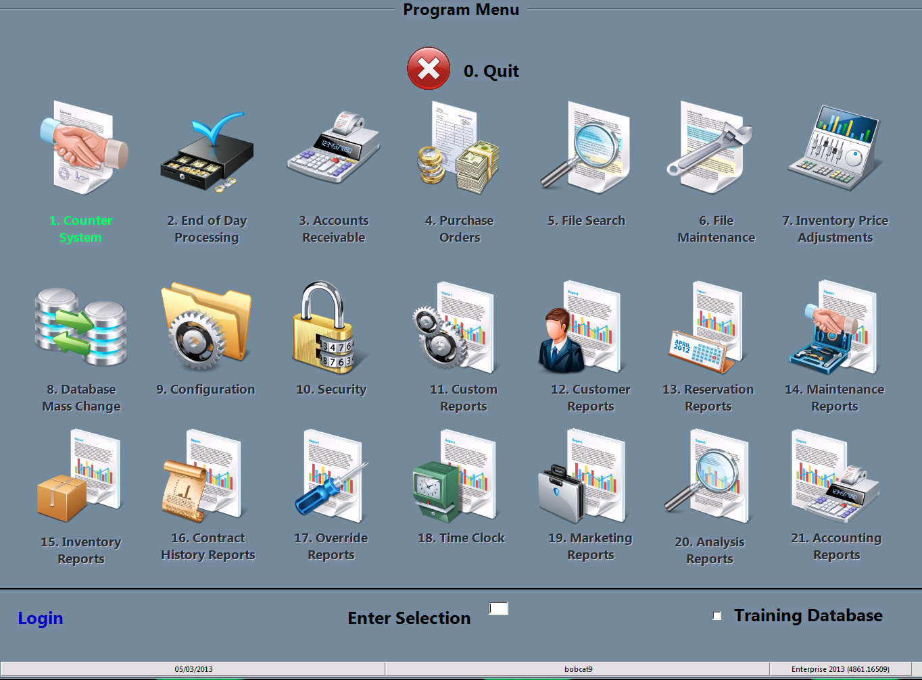
Select counter system
You may either double click the 1.Counter System icon or type the #1 in the “Enter Selection” space then press enter

Slide 4
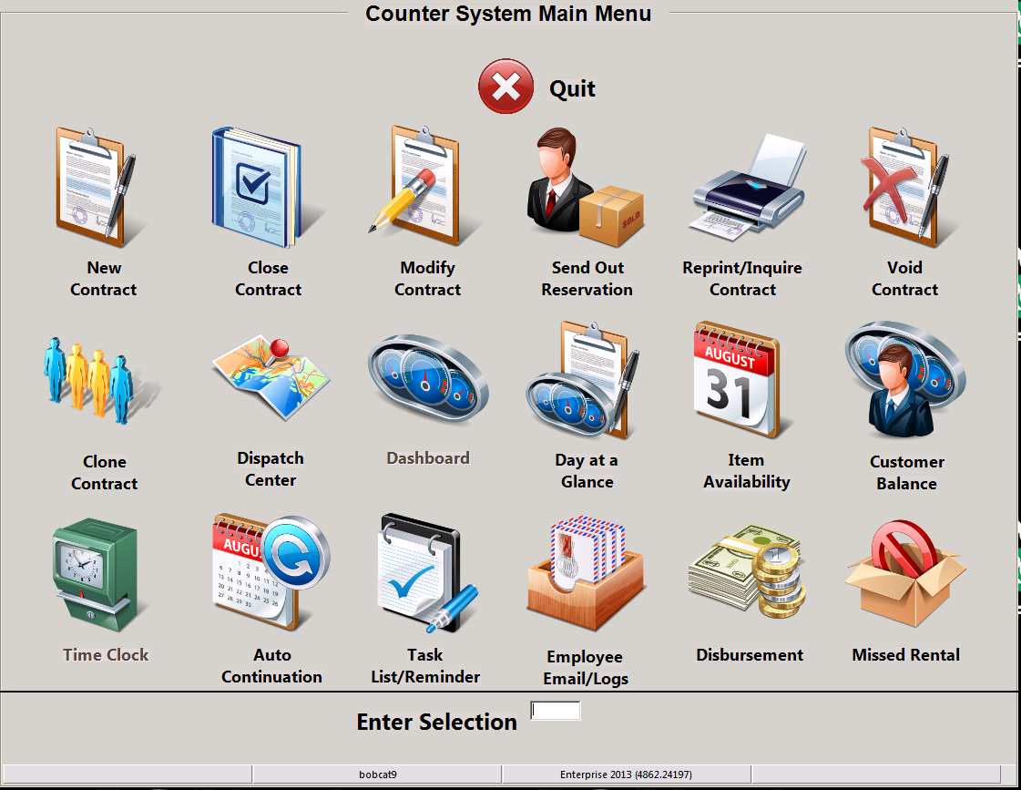
Select new contract
You may either double click the New Contract icon or type the #1 in the “Enter Selection” space then press enter

Slide 5
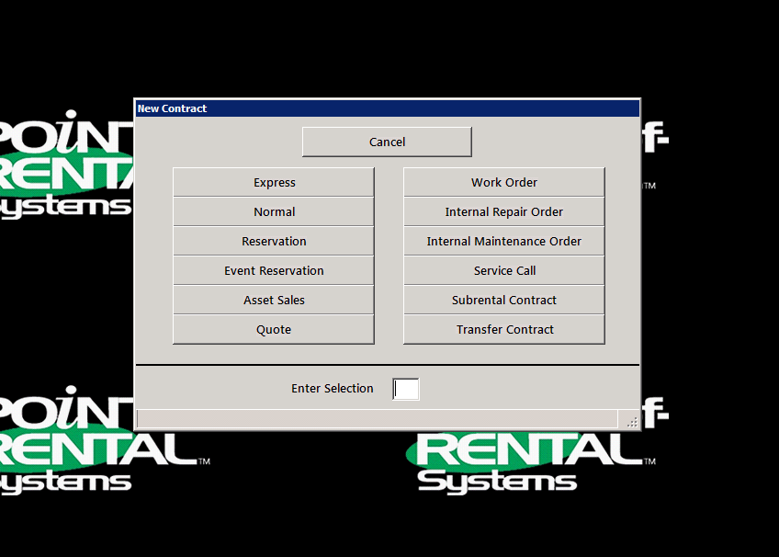
Select normal
You may either double click the Normal icon or type the #2 in the “Enter Selection” space then press enter

Slide 6
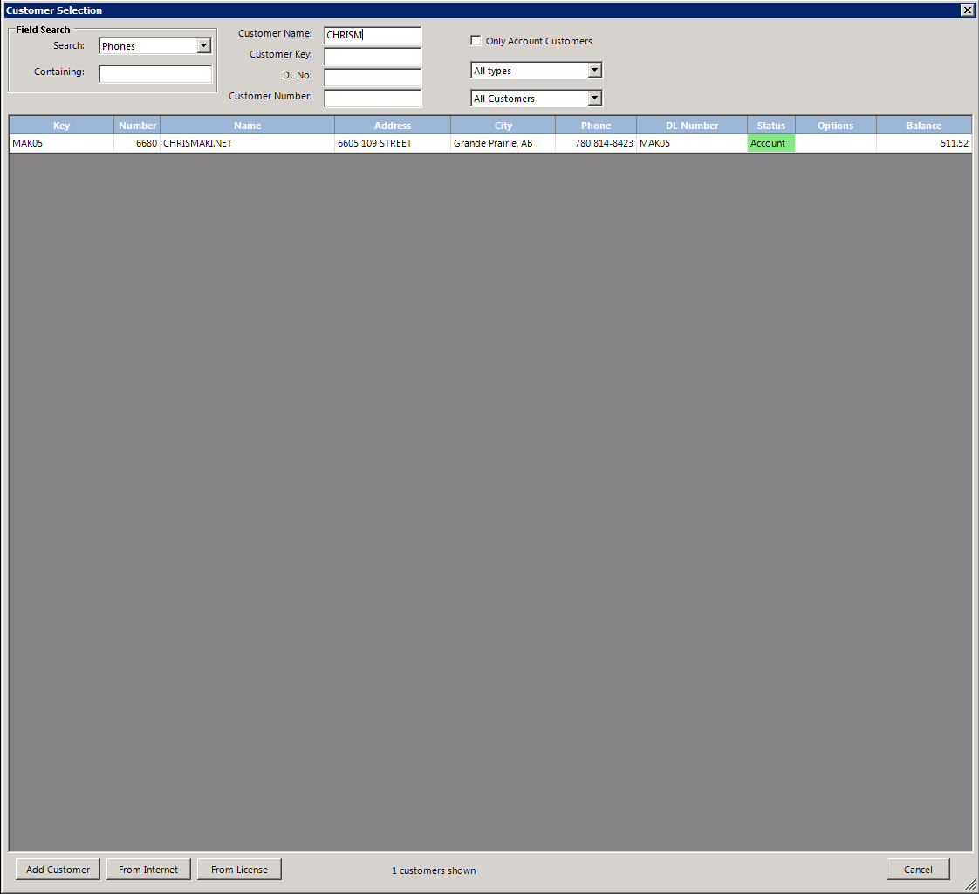
Select customer
You may type the customers name in the Customer Name: slot, type in the customer key in the Customer Key: slot or search using one of the various search criteria provided in the Search: drop menu. Once you locate the correct account select it by clicking on it. If the account is not able to be found ask management for assistance

Slide 7
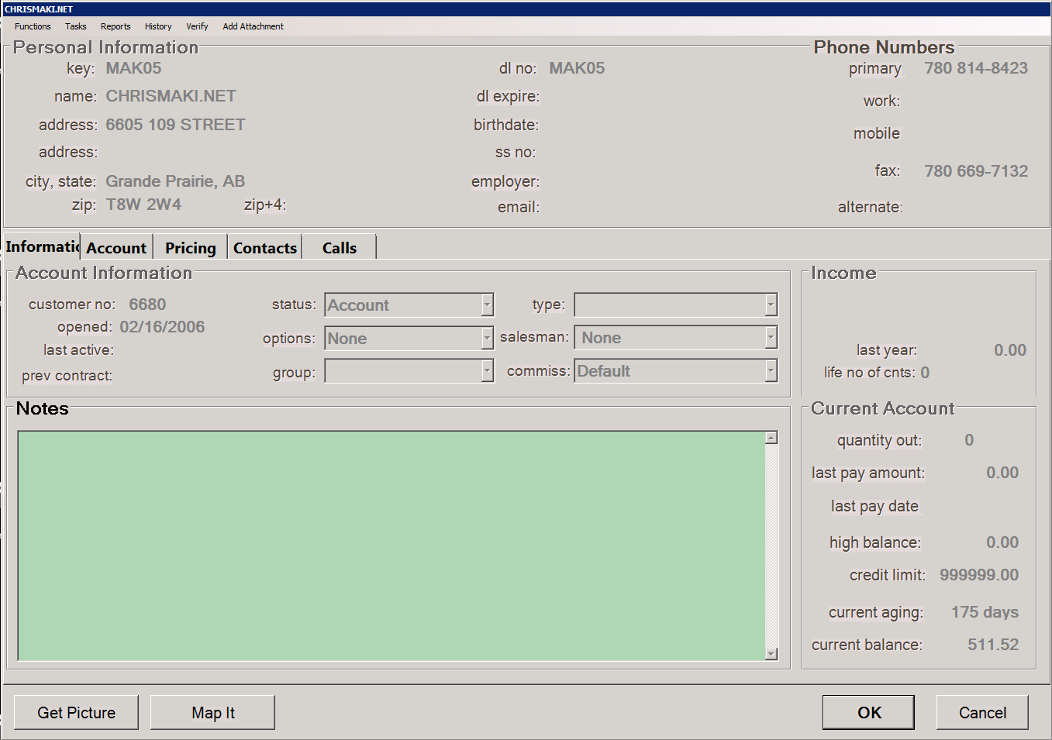
Select customer
Verify you have the correct account then click the OK button or press enter. If the customer is passed due or over their credit limit you may need management approval to proceed

Slide 8
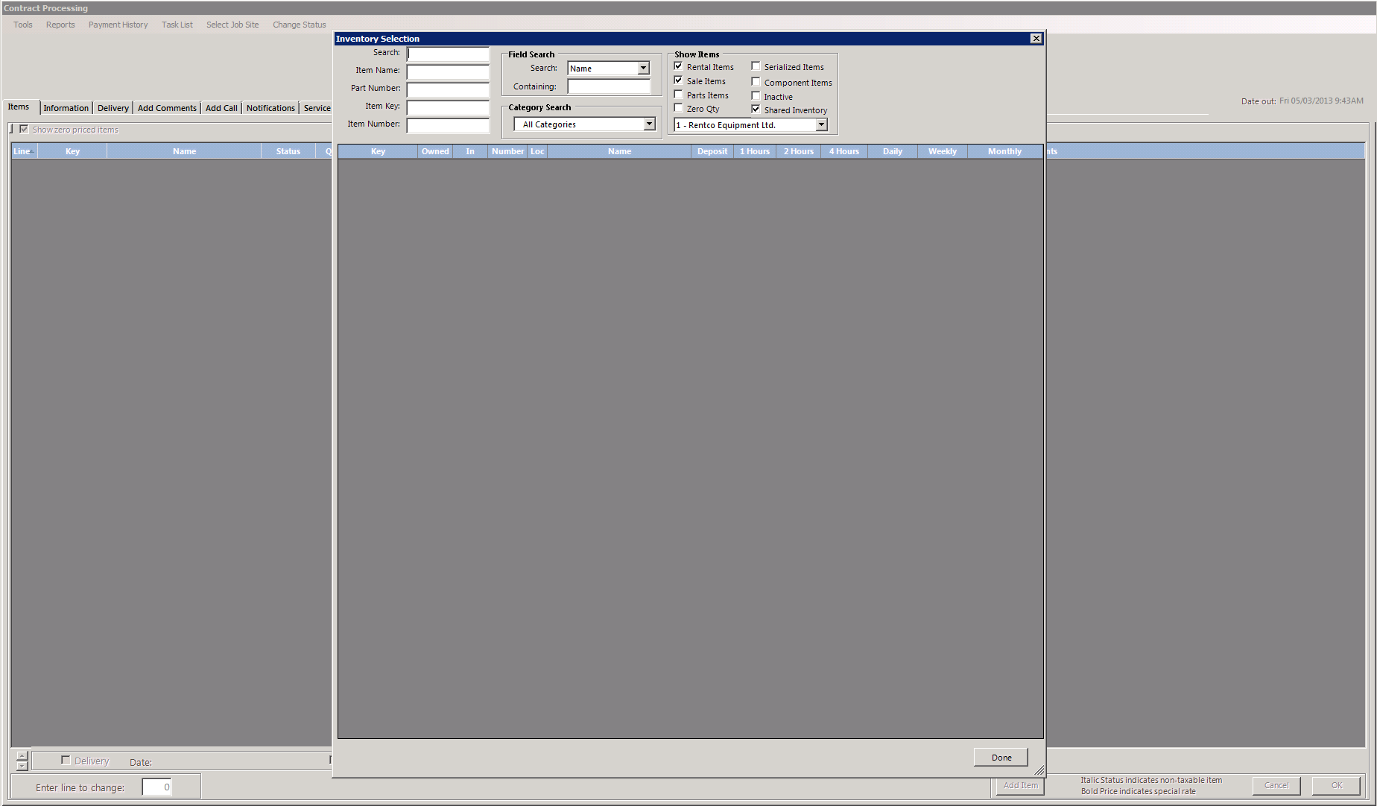
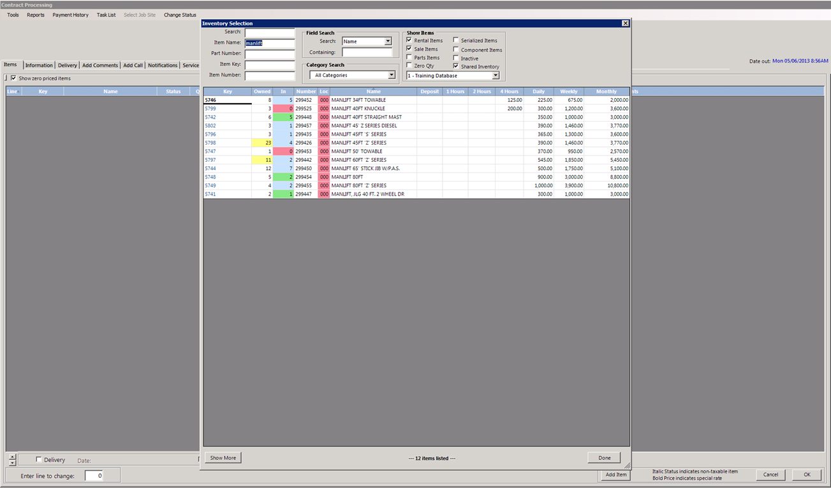
Select item
You may search by item name, item key, or any of the other search criteria. You must insure your are selecting items from your locations by clicking your location in the drop down menu situated under the Show Items section. You may also narrow your search by eliminating unnecessary fields such as Sales Items if your looking for rental items

Slide 9
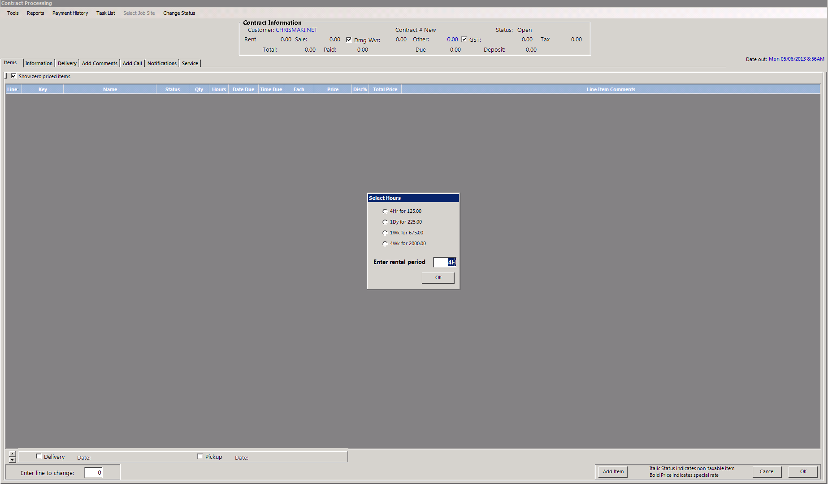
Select rental length
You will be given the option to pick any of the rental lengths that item has been setup with. If the customer is unsure how long they would like to keep the item use their best guess, if they still don’t know enter one day

Slide 10
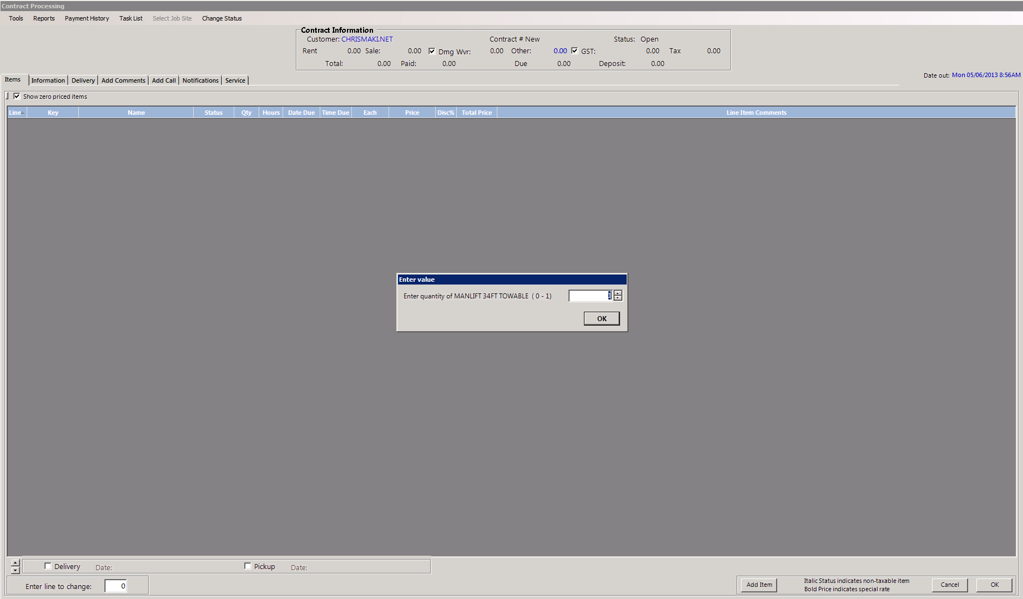
Select rental quantity
You will be given the option to pick the quantity of your selected item, if it is a multi item you may pick as many as are available to rent, if it is a serialized item you will only be able to pick one.

Slide 11
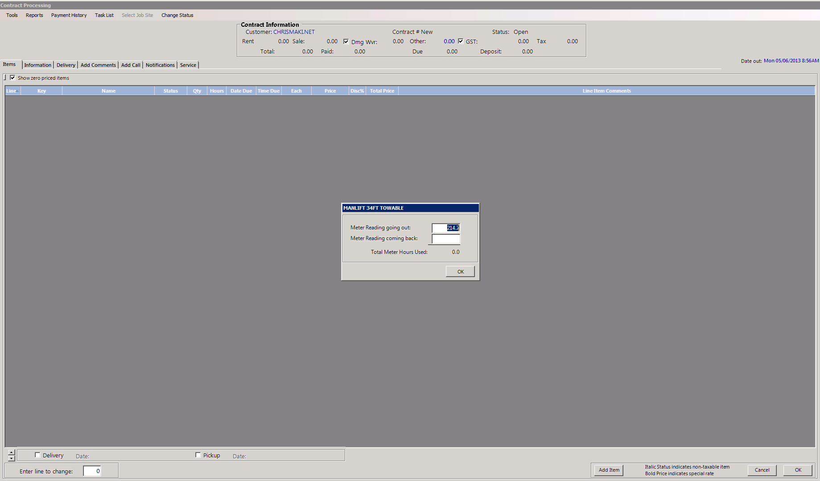
Input your hour meter
If the item has an hour meter, input the value in the going out slot provided, confirm with a visual inspection that this value is correct

Slide 12
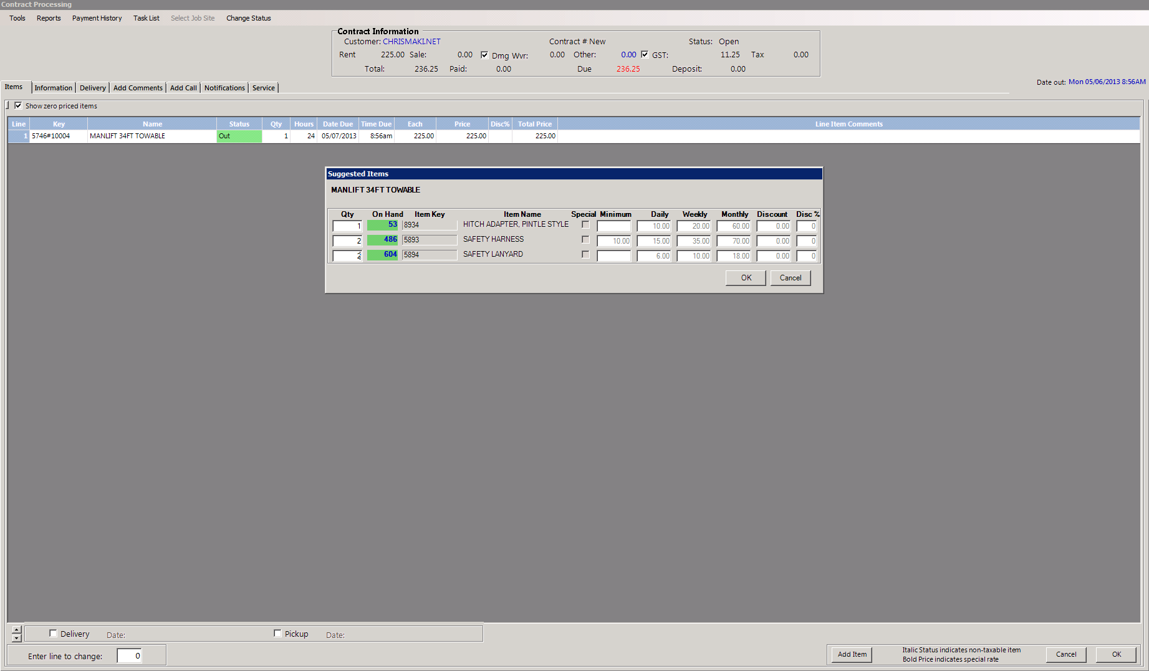
Suggested items
If the item has been created with a list of suggested items they will appear now giving you the option to select them. please note if it is a serialized item (has a unit number 0000#00000) you may only add one of each. If it is a multi number (has a unit number 0000m-1) you may add as many as are available.

Slide 13
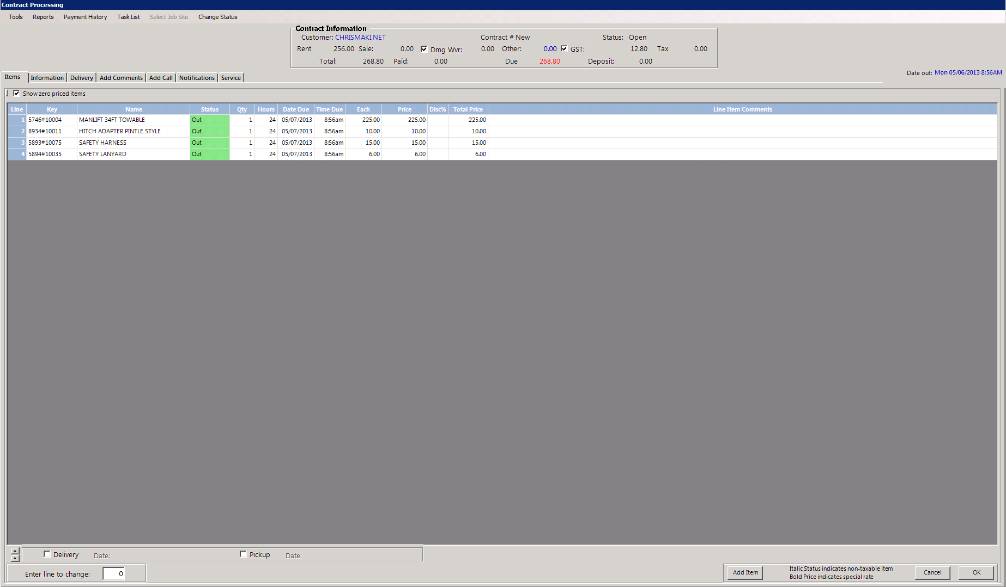
Additional items
You may now continue to add additional items to the contract as required. These may be rental items or sales items. Simply follow the previous step until all items are added.

Slide 14
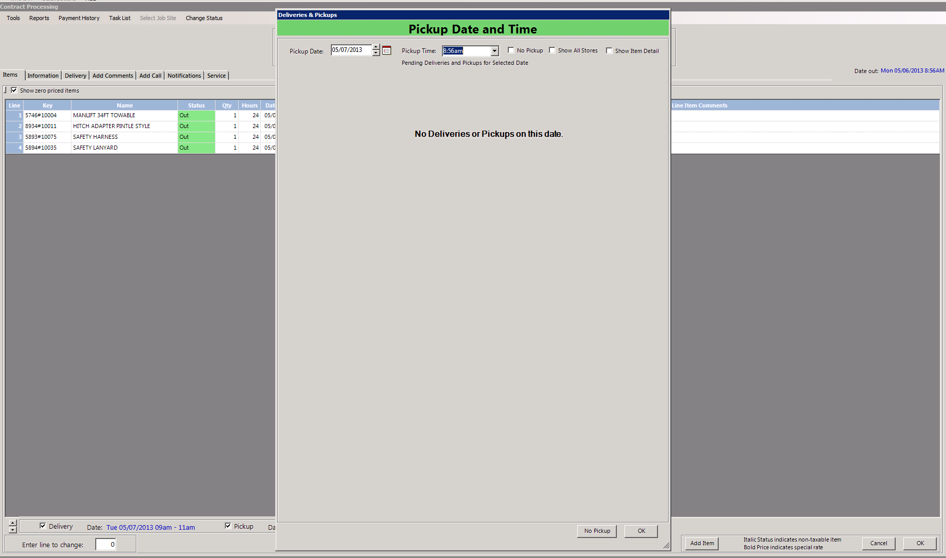
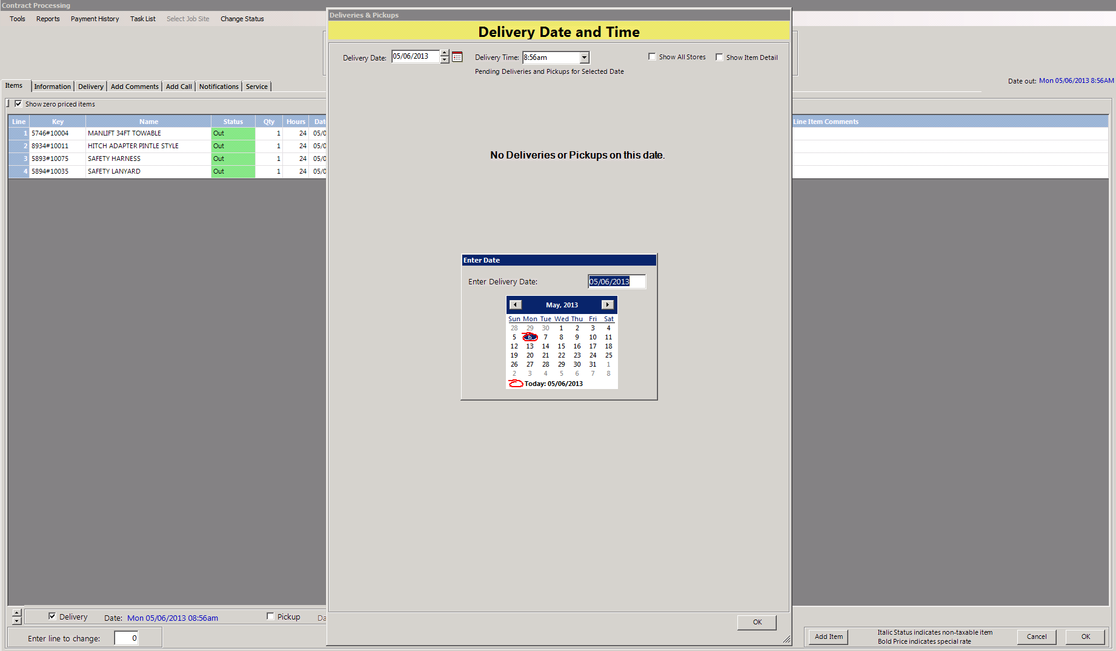
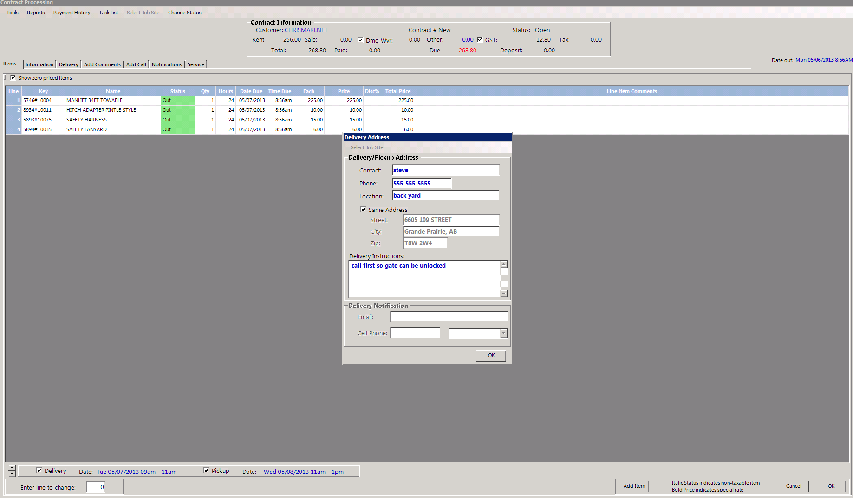
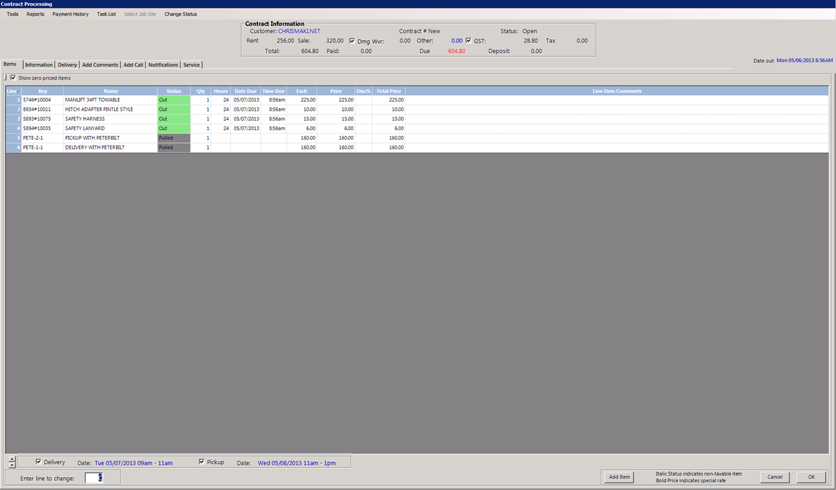
Setting delivery
If delivery is required you can select it at the bottom left corner by clicking on the check box. You will then be prompted to select the time and date and enter your delivery location. Your delivery time should only be set if you know when the driver is available. Please be aware this only books delivery and pick up, you must charge for it by adding the proper delivery charge using the item key required.

Slide 15
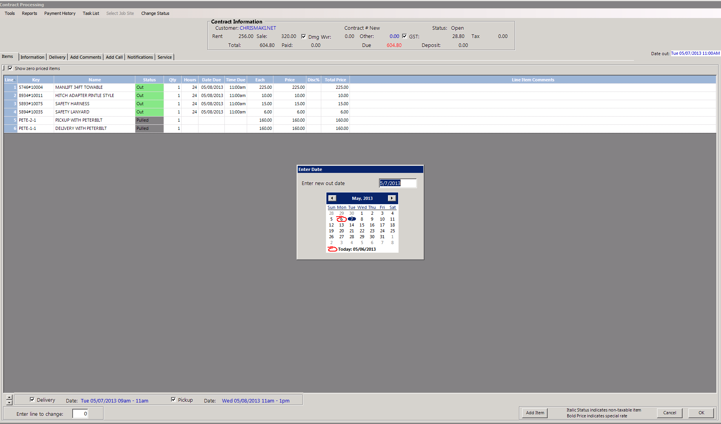
Time and date out
You may on occasion need to adjust the time out to reflect delivery time or other reasons. This can be accomplished by clicking the date out in the upper right of the screen. The time out can not be before the delivery time.

Slide 16
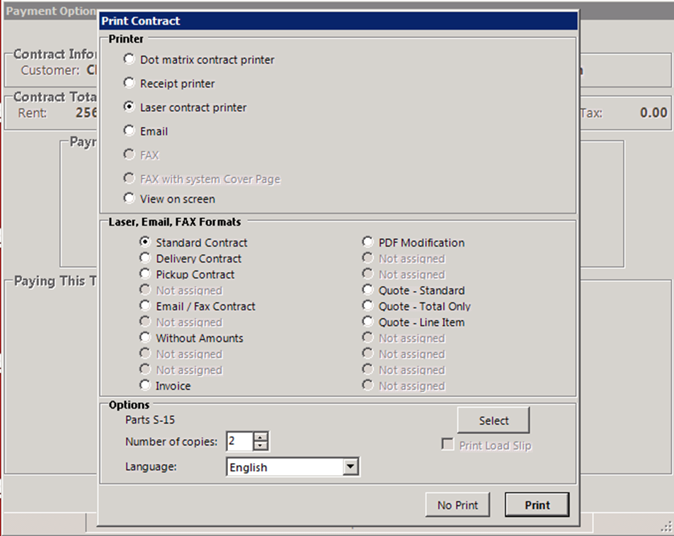
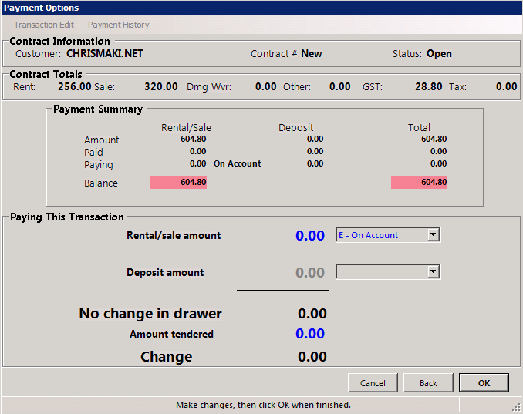
Finishing off
On a charge account deposits and prepayments are not required. At this point you must simply click ok. It will then ask you if you would like to print, email or view on the screen, note that faxing from this screen is currently unavailable.

Slide 17
You have completed this training session
If you have any questions please ask your manager before writing contracts. And remember to practice using the training mode.

