Slide 1

Point of Rental Training
Please proceed at your own pace. Press the right arrow key to move though the training or left to go back, each slide will automatically advance after a few seconds.

Slide 2
item inter-store transfer
sales items

Slide 3
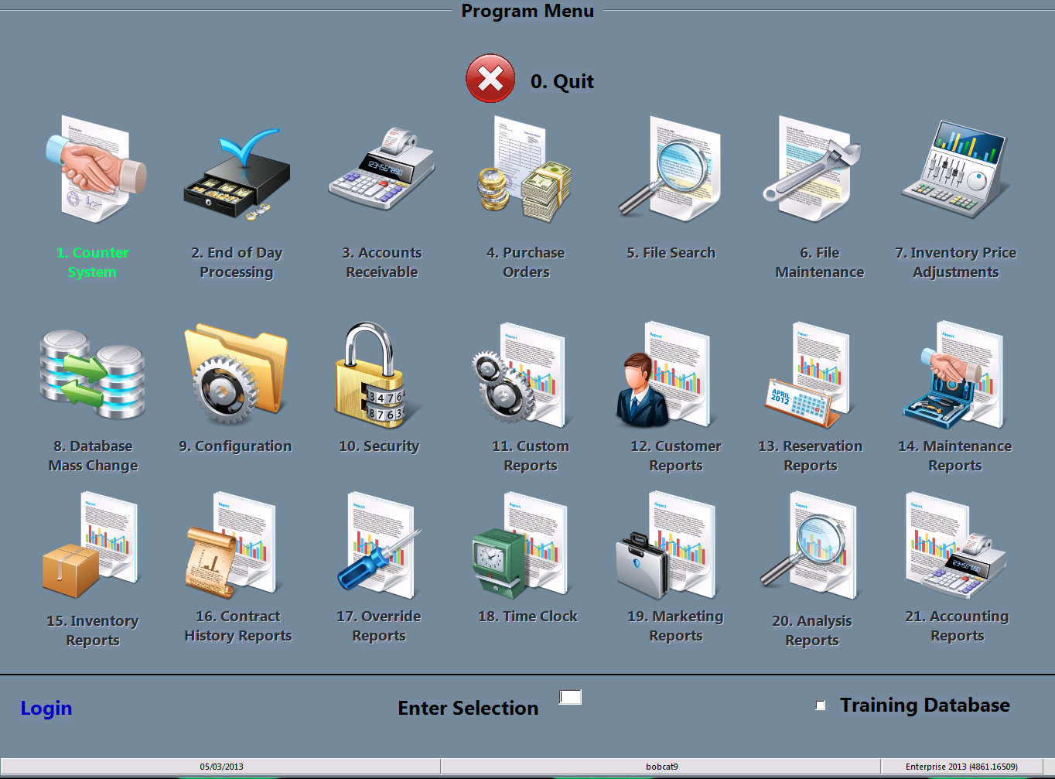
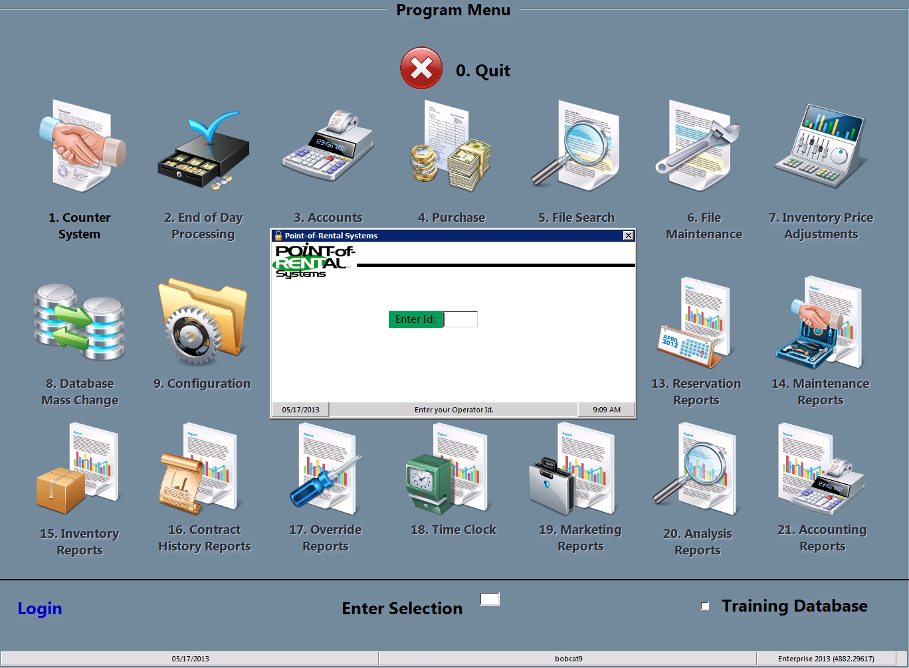
Select login
You must start by clicking the Login at the bottom left of the screen and typing in your password.

Slide 4
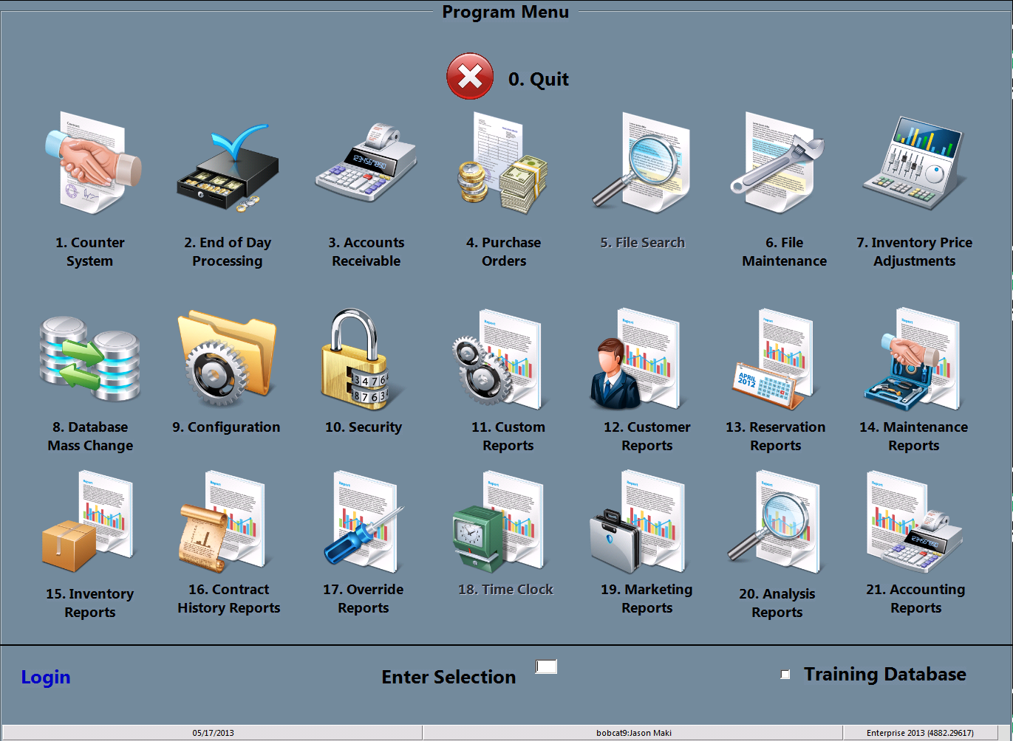
Select counter system
You may either double click the counter system icon or type the #1 in the “Enter Selection” space then press enter

Slide 5
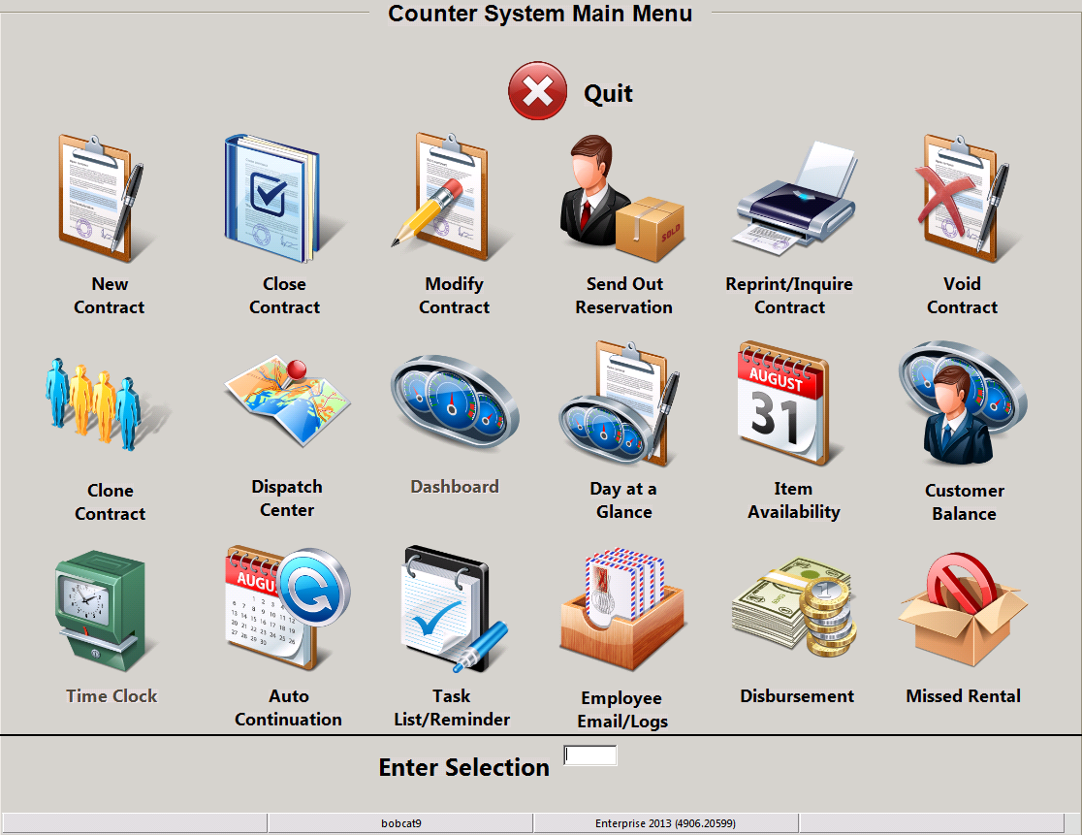
Select new contract
You may either double click the New Contract icon or type the #1 in the “Enter Selection” space then press enter

Slide 6
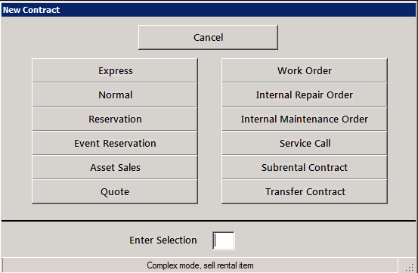
Select transfer contract
You may either double click the Transfer contract icon or type the #12 in the “Enter Selection” space then press enter

Slide 7
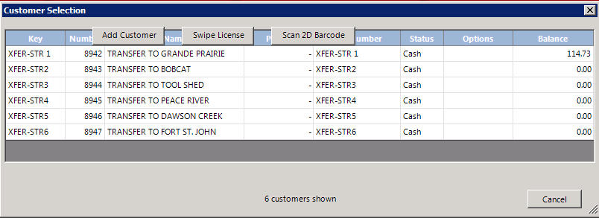
Select transfer location
At this point you must select the location you wish to transfer your item to. It will also ask if you are transferring now, if you select yes it will do everything that moment. Selecting no will allow you to select a future time and date to finish the contract (most times select yes)

Slide 8
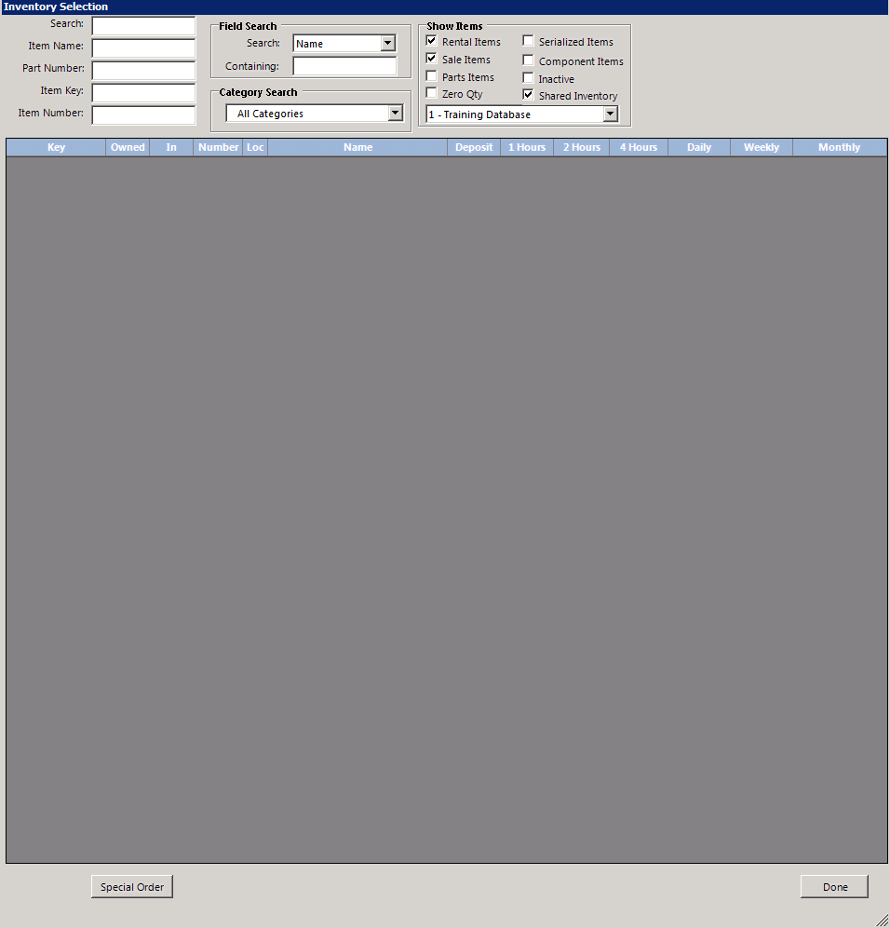
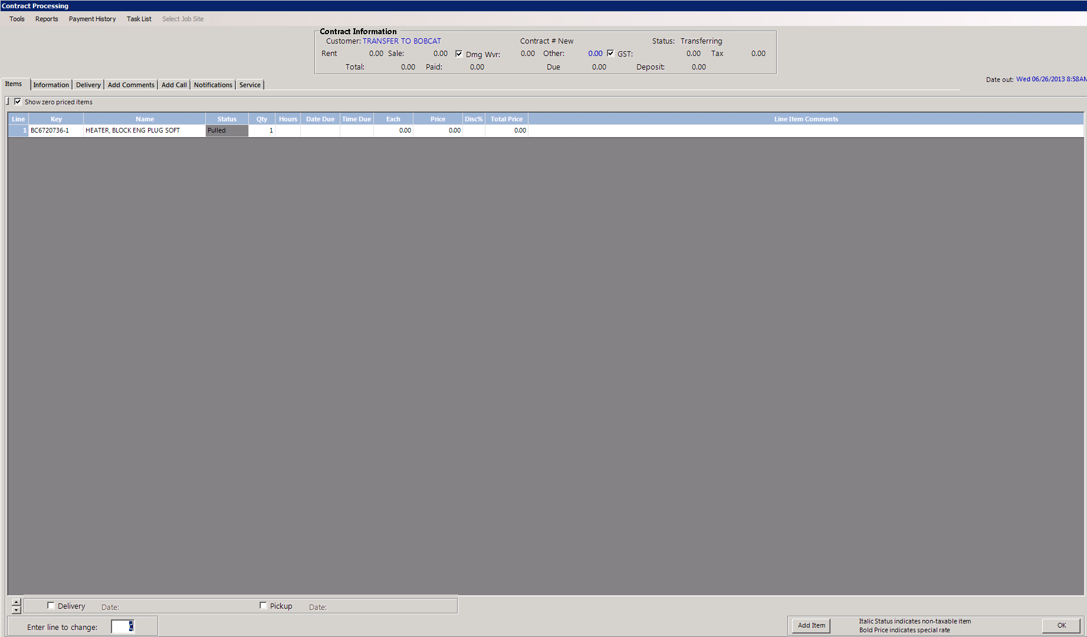
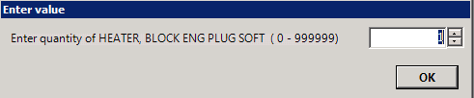
Input item
Input the item(s) you wish to transfer by item key, item name, or by searching and selecting it. Now select the quantity of each item you are sending and press enter.

Slide 9
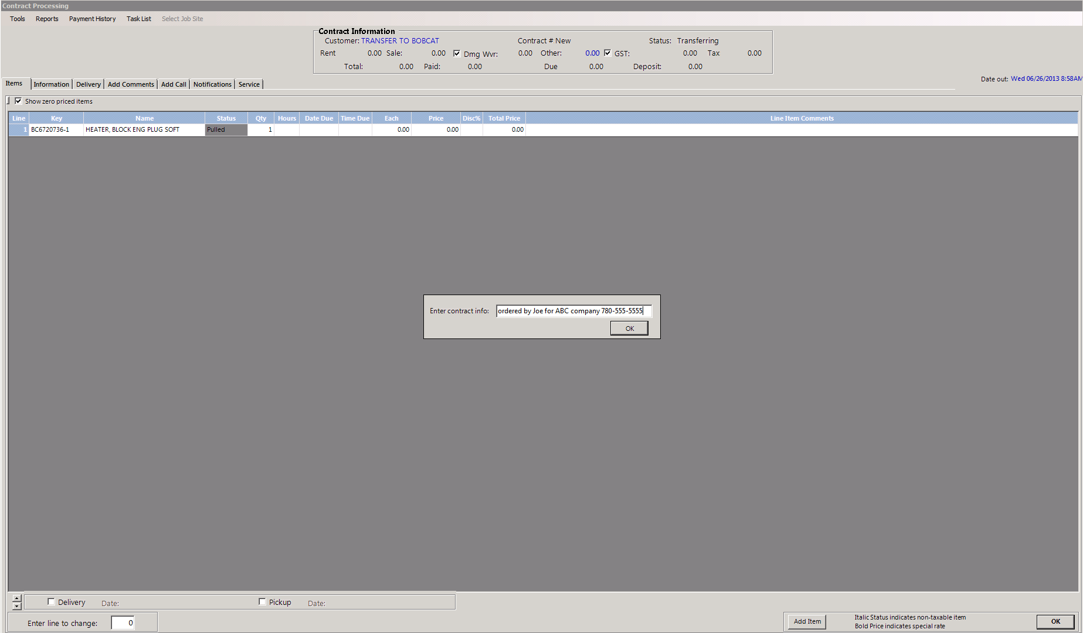
INPUT INFORMATION
Input the contact information, who ordered it within Rentco and who they are bringing it in for, workorder numbers or phone numbers are very helpful

Slide 10
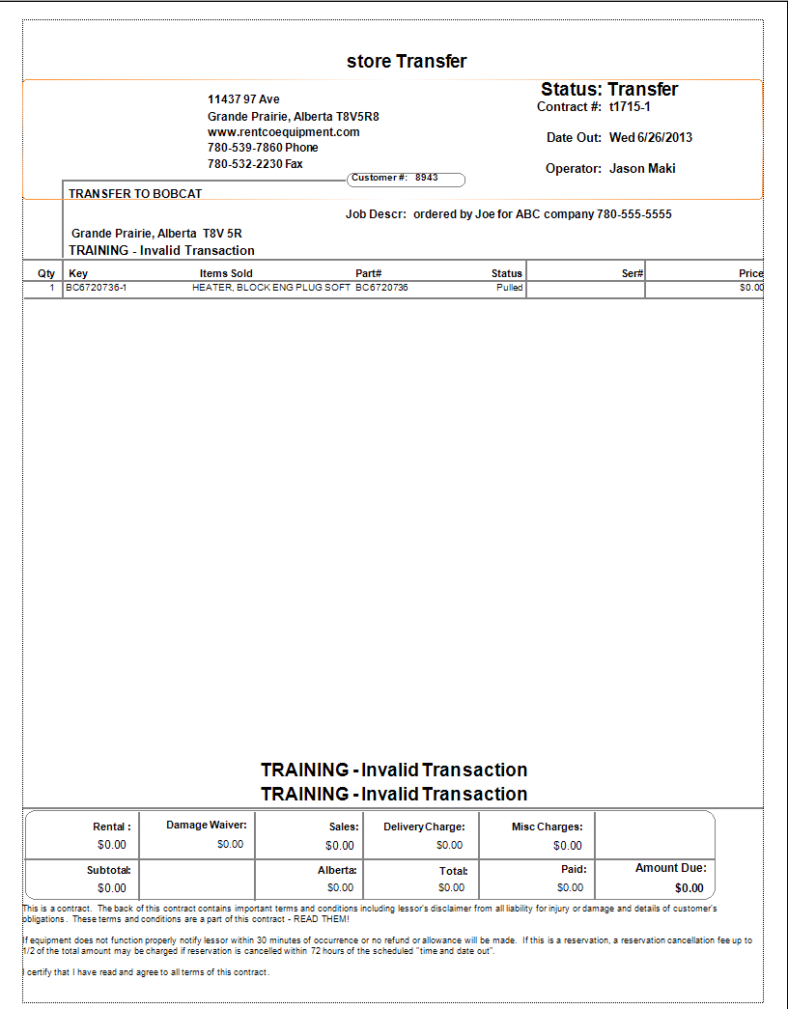
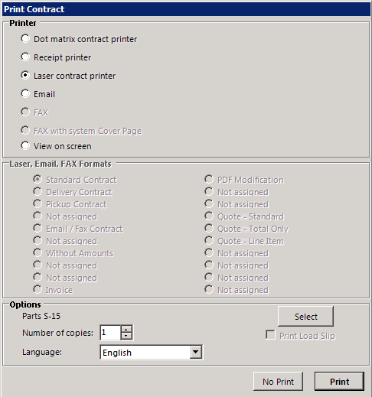
Print a copy
Print a copy of the transfer to send with the item. You can also email a second copy to the person your sending it to

Slide 11
You have completed this training session
If you have any questions please ask your manager before adding sales items. And remember to practice using the training mode.

